Slide 1


Reaching Impact, Saturation, and Epidemic Control (RISE): Blood Gas Analysis
Notes:
May add the MOH logo if required/requested by host country government

Slide 2
Learning Objectives:
Describe various aspects of ABG sampling.
Describe normal acid-base hemostasis.
Arterial blood gas interpretation.

Slide 3
Arterial Blood Gas Sampling

Slide 4
Indications of ABG
Identification and monitoring of acid base disturbances.
Measurement of the partial pressures of oxygen (PaO₂) and carbon dioxide (PaCO₂).
Assessment of the response to therapeutic interventions (eg: insuli in patients with diabetic ketoacidosis)
Procurement of blood sample in an acute emergency setting when venous sampling is not feasible.

Slide 5
Relative Contraindications
Supra Therapeutic coagulopathy and infusion of thrombolytic agents (eg: during streptokinase or tissue plasminogen activator infusion)
Relative contraindication to arterial needle stick
Absolute contraindication to indwelling catheter insertion.
INR ≥ 3, ApTT ≥ 100 secs

Slide 6
Relative Contraindications
THROMBOCYTOPENIA
Platelet Counts ≥ 50 x 10⁹
can perform arterial needle stick
Can perform catheter insertion
Platelet Counts ≤50 x 10⁹ and ≥ 30x10⁹
can perform arterial needle stick
Catheter insertion contraindicated.
Platelet Counts ≤ 30x10⁹
can perform arterial needle stick
Catheter insertion contraindicated.

Slide 7
Absolute Contraindications for ABG sampling
An abnormal modified Allens Test
Local infection, thrombus, or distorted anatomy at puncture site (eg: pervious surgical interventions, congenital or acquired malformations, burns, aneurysms, AV fistula, vascular grafts etc).
Severe peripheral vascular disease of artery selected for sampling
Active Raynaud's syndrome ( particularly samples at Radial Site).

Slide 8
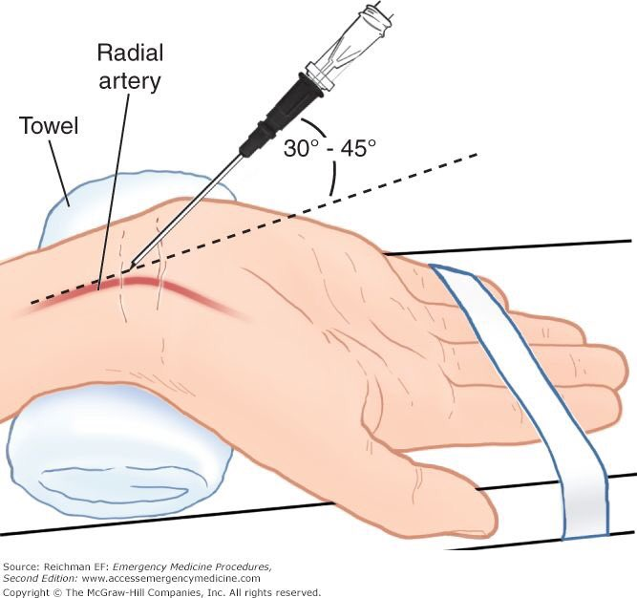
Complications (sampling)
Common
Local pain and paresthesia
Bruising
Local minor bleeding
Less Common
Vasovagal Response
Local hematoma from moderate or major bleed.
Artery vasospasm

Slide 9

Complications (sampling)
Rare
Infection at puncture site
Arterial occlusion from a local hematoma
Air or thrombus embolism
Local nerve injury
Needle stick injury to health care worker
Pseudoaneurysm
Vessel laceration.

Slide 10
Sources of Error
 | Problem | Effect | Solution
1. | Gas difussion through plastic Oxygen consumption by platelets and leucocytes | ↓↓ PaO₂ | Place on Ice Analyze within 15 mins
2. | Use of Heparin | Can ↓pH Dilute PaCO₂ | Minimal heparin to be used in the syringe At least 2ml of Blood
3. | Air Bubbles | ↑ PaO₂ ↓PaCO₂ | Gently tap syringe to remove bubbles Analyze early

Slide 11
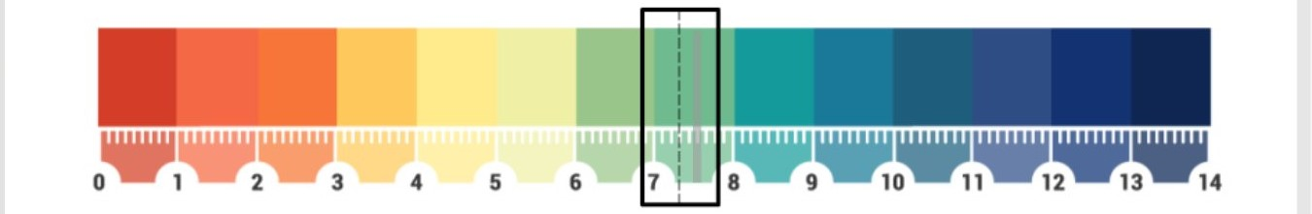
Acid Base Hemostasis

Slide 12
Introduction
Precise Regulation of pH ( 7.35 to 7.45) is essential.
Proper balance between acid and bases in the ECF is crucial for normal physiology of the body and for cellular metabolism.
Outside the acceptable range of pH (< 7.2 or > 7.55), proteins are denatured, causing enzymes and ion channels to malfunction.

Slide 13
Basic Terminology
pH | pH signifies free hydrogen ion concentration. pH is inversely related to H⁺ ion concentration.
Acid | A substance that can “donate” H⁺ ion or when added to solution raises H⁺ ion conc. (i.e lowers pH)
Base | A substance that can “accept” H⁺ ion or when added to solution lowers H⁺ ion conc. (i.e raises pH)
Anion | An ion with negative charge is anion (e.g Cl⁻, HCO₃⁻)
Cation | A ion with a positive charge is Cation (i.e Na^{+,} K⁺)

Slide 14
Basic Terminology
Acidemia | Acidemia means “acid blood” refers to a blood pH below normal (pH < 7.35) and increased H⁺ ion concentration.
Alkalemia | Alkalemia means “alkaline blood” referes to blood pH above normal (pH> 7.45) and decreased H⁺ ion concentration.
Acidosis | Any condition that acts to increase [H⁺] whether through endogenous production, decreased buffering capacity, decreased excretion or exogenous addition is known as acidosis. The pH may remain within range.
Alkalosis | Similarly any condition that acts to decrease [H⁺] is termed as alkalosis, pH may remain within normal limits.

Slide 15
Normal Values
Blood | PaCO₂ | pH | PaO₂ | Sao₂ | HCO₃ | BE
Arterial | 35-45 | 7.35-7.45 | 80-100 | >95% | 22-26 | ± 3
Venous | 42-50 | 7.34-7.42 | 37-42 | 71-78% | 22-26 | ± 3
 | Normal Range
Anion Gap (meq/L) | 10-14
Osmolar Gap (mOsm/kg) | 10
PaO₂/FiO₂ (%) | > 3

Slide 16
Basic physiology of acid base regulation
Body maintains pH within a normal range in spite of variation in dietary intake of acid and alkali, and endogenous acid production.
Endogenous Acid Production
Volatile Acid
Nonvolatile (fixed) Acid
H₂CO₃
Determines level of CO₂ in blood (PaCO₂) and is extended by lung.
Sulphuric and Phosphoric acid
Produced by dietary and endogenous protein catabolism.
Excreted by Kidney.

Slide 17
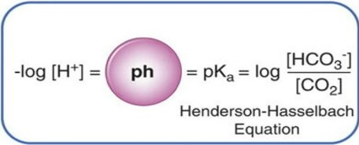
Regulation of Acid Base
Is the function of buffers, lungs and kidneys. Liver acts as the third organ for acid base regulation.
Acid-base hemostasis is maintained by respiratory control of the partial pressure of carbon dioxide (PCO₂) through changes in alveolar ventilation and control of HCO₃⁻ reabsorption and H⁺ excretion by kidneys.
Henderson-Hasselbalch equation describes the co-relation of metabolic and respiratory regulation, which maintains pH.

Slide 18



Hydrogen Ion Homeostasis
H+
Ingestion
Excretion
Metabolism
Hemoglobin
Protein
H₂CO₃
Metabolism
CA*
HCO3⁻
CO₂+H₂O
Excretion
*Carbonic anhydrase

Slide 19
Regulation of Acid Base
Buffers:
Chemical systems which either release or accept H⁺.
Minimize change in pH induced by an acid or base.
Provide immediate defense.
Act fastest but has least buffering power.
E.g. Bicarbonate, phosphate, proteins, hemoglobin, and bone bicarbonate.

Slide 20
Regulation of Acid Base
Respiratory Regulation
By excreting volatile acids, lung regulates PaCO₂.
Modulated by brainstem respiratory centers, which alters alveolar ventilation in an attempt to keep plasma pH within normal range.
The chemoreceptor sense any derangement in acid base balance and send afferent signals to brainstem respiratory centers.
Respiratory regulation acts rapidly ( in seconds to minutes) and has double buffering power as compared to chemical buffers.

Slide 21
Regulation of Acid Base
Renal Regulation:
Maintain plasma HCO₃ concentration and thereby pH regulation.
Most powerful buffer system, which starts within hours, and takes 5-6 days to peak effect.
Kidney regulates HCO₃ by excreting non-volatile fixed acids by following three main mechanisms:
Excretion of H⁺ ion by tubular secretion.
Reabsorption of filtered bicarbonate ions.
Production of new HCO₃⁻ ions.

Slide 22
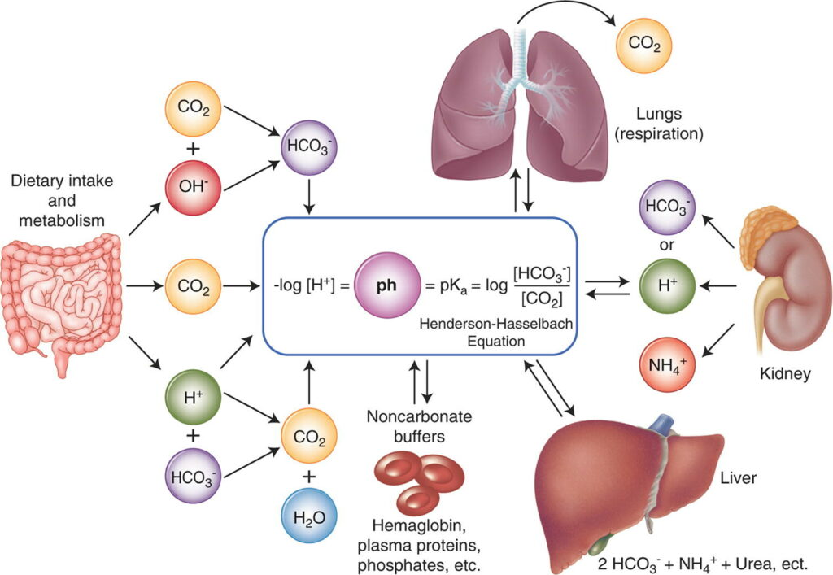
Regulation of Acid Base
https://www.physoc.org/magazine-articles/an-introduction-to-stewart-acid-base/

Slide 23
Acid Base Disorders

Slide 24
Primary acid base disorders
Four primary acid base disorders are defined depending upon initial disturbances.
Primary Disorder | Primary Change | Compensatory Change
Respiratory Acidosis | ↑ PCO₂ | ↑ HCO₃⁻
Respiratory Alkalosis | ↓ PCO₂ | ↓HCO₃⁻
Metabolic Acidosis | ↓HCO₃⁻ | ↓ PCO₂
Metabolic Alkalosis | ↑HCO₃⁻ | ↑PCO₂

Slide 25
Secondary Responses/Compensation in Acid Base Disorders
Body’s response to neutralize the effect of initial insult on pH hemostasis is called compensation.
Remember that pH is maintained by ratio of HCO₃/PaCO₂ ( Henderson-Hasselbalch equation)
So primary metabolic disorders (primary change in HCO₃) lead to compensatory respiratory responses ( Secondary change in PaCO₂)
And
Primary respiratory disorder (primary change in PaCO₂) leads to compensatory metabolic responses (secondary change in HCO₃)

Slide 26
Secondary Responses/Compensation in Acid Base Disorders
Response to metabolic Acid:
Response to metabolic acid base disorder involves change in minute ventilation mediated by chemoreceptors located in carotid body.
Secondary response to metabolic acidosis is increase in minute ventilation.
Response appears in 30-120 minutes, can take 12-24 hrs to complete.
Magnitude of response:
ΔPaCO₂ = 1.2 x Δ HCO₃⁻
Considering normal values of PaCO₂ = 40 mmhg
And HCO₃⁻= 24mEq/L
Expected PaCO₂ = 40 [ 1.2 x (24 – current HCO₃⁻]

Slide 27
Secondary Responses/Compensation in Acid Base Disorders
Response to metabolic alkalosis:
Secondary Response to metabolic alkalosis is decrease in minute ventilation.
Magnitude of response to metabolic alkalosis is defined by equation
ΔPaCO₂ = 0.7 Δ HCO₃⁻
Hence,
Expected PaCO₂= 40 + [ 0.7 x ( current HCO₃⁻ - 24]

Slide 28
Secondary Responses/Compensation in Acid Base Disorders
Response to respiratory disorders:
Secondary response to changes in PaCO2 occurs in kidneys. HCO3 absorption in the proximal tubes is adjusted to produce the appropriate change in plasma HCO3.
Response is relatively slow, takes 2 or 3 days to reach completion.
Because of the delay in the secondary response, respiratory acid-base disorders are separated into acute and chronic disorders.

Slide 29
Secondary Responses/Compensation in Acid Base Disorders
Acute Respiratory Response:
Acute changes in PaCO2 have a small effect on the plasma HCO3, as indicated in the following two equations
For acute respiratory acidosis:
ΔHCO₃ = 0.1 x ΔPaCO₂
For acute respiratory alkalosis:
ΔHCO₃= 0.2 x ΔPaCO₂

Slide 30
Secondary Responses/Compensation in Acid Base Disorders
Chronic Respiratory disorders:
For chronic respiratory acidosis:
Expected HCO₃= 24 + [ 0.4 x (current PaCO₂ – 40)]
For chronic respiratory alkalosis:
Expected HCO₃ = 24 – [ 0.4 x ( 40 – Current PaCO₂)]
EXAMPLE: For an increase in PaCO2 to 60 mm Hg that persists for at least a few days,the ΔPaCO2 is 60 – 40 = 20 mm Hg, the ΔHCO3 is 0.4×20 = 8 mEq/L, and the expected HCO3 is 24 + 8 = 32 mEq/L.

Slide 31

Arterial Blood Gas Interpretation

Slide 32
Arterial Blood Gas Interpretation
Step 1:
The first step in ABG interpretation would be to check the validity of the sample. This can be done using the Henderseon-Hasselbach equation:
[H+] = 24(PaCO₂) [HCO₃-]
Now Compare the calculated value of H⁺ with pH using the nomogram displayed in the next slide.
If the pH and the [H+] are inconsistent, the ABG is probably not valid.

Slide 33
Arterial Blood Gas Interpretation
pH | Approximate [H+] (nmol/L)
7.00 | 100
7.10 | 79
7.20 | 63
7.30 | 50
7.40 | 40
7.50 | 32
7.60 | 25

Slide 34
Arterial Blood Gas Interpretation
Step 2:
Is there alkalemia or acidemia present?
pH < 7.35 acidemia pH > 7.45 alkalemia
This is usually the primary disorder
(Remember: an acidosis or alkalosis may be present even if the pH is in the normal range (7.35 – 7.45))
You will need to check the PaCO₂, HCO₃- and anion gap.

Slide 35
Arterial Blood Gas Interpretation
Step 3:
Is the disturbance respiratory or metabolic?
What is the relationship between the direction of change in the pH and the direction of change in the PaCO₂?
In primary respiratory disorders, the pH and PaCO2 change in opposite directions; in metabolic disorders the pH and PaCO₂ change in the same direction.

Slide 36
Arterial Blood Gas Interpretation
Acidosis | Respiratory | pH ↓ | PaCO₂ ↑
Acidosis | Metabolic | pH ↓ | PaCO₂ ↓
Alkalosis | Respiratory | pH ↑ | PaCO₂ ↓
Alkalosis | Metabolic | pH ↑ | PaCO₂ ↑

Slide 37
Step 4:
Is there appropriate compensation for the primary disturbance? Usually, compensation does not return the pH to normal (7.35 – 7.45)
Disorder | Expected compensation | Correction factor
Metabolic acidosis | PaCO₂ = (1.5 x [HCO₃-]) +8 | ± 2
Acute respiratory acidosis | Increase in [HCO₃-]= ∆ PaCO₂/10 | ± 3
Chronic respiratory acidosis (3-5 days) | Increase in [HCO₃-]= 3.5(∆ PaCO₂/10)
Metabolic alkalosis | Increase in PaCO₂ = 40 + 0.6(∆HCO₃-)
Acute respiratory alkalosis | Decrease in [HCO₃-]= 2(∆ PaCO₂/10)
Chronic respiratory alkalosis | Decrease in [HCO₃-] = 5(∆ PaCO₂/10) to 7(∆ PaCO₂/10)

Slide 38
Arterial Blood Gas Interpretation
Step 5:
Calculate the anion gap (if a metabolic acidosis exists): AG= [Na+]-( [Cl-] + [HCO₃-] )-12 ± 2
A normal anion gap is approximately 12 meq/L.
In patients with hypoalbuminemia, the normal anion gap is lower than 12 meq/L; the “normal” anion gap in patients with hypoalbuminemia is about 2.5 meq/L lower for each 1 gm/dL decrease in the plasma albumin concentration (for example, a patient with a plasma albumin of 2.0 gm/dL would be approximately 7 meq/L.)

Slide 39
Arterial Blood Gas Interpretation
If the anion gap is elevated, consider calculating the osmolal gap in compatible clinical situations.
Elevation in AG is not explained by an obvious case (DKA, lactic acidosis, renal failure
Toxic ingestion is suspected
OSM gap = measured OSM – (2[Na+] - glucose/18 – BUN/2.8
The OSM gap should be < 10

Slide 40
Arterial Blood Gas Interpretation
Step 6:
If an increased anion gap is present, assess the relationship between the increase in the anion gap and the decrease in [HCO₃-].
Assess the ratio of the change in the anion gap (∆AG ) to the change in [HCO3-] (∆[HCO₃-]): ∆AG/∆[HCO₃-]
This ratio should be between 1.0 and 2.0 if an uncomplicated anion gap metabolic acidosis is present.

Slide 41
Arterial Blood Gas Interpretation
If this ratio falls outside of this range, then another metabolic disorder is present:
If ∆AG/∆[HCO₃-] < 1.0, then a concurrent non-anion gap metabolic acidosis is likely to be present.
If ∆AG/∆[HCO₃-] > 2.0, then a concurrent metabolic alkalosis is likely to be present.
It is important to remember what the expected “normal” anion gap for your patient should be, by adjusting for hypoalbuminemia (see Step 5, above.)

Slide 42
ACIDOSIS- ALGORITHM
pH < 7.35
[HCO₃⁻] low
PCO₂ elevated (>40)
Δ↓ PCO₂
Δ↓ HCO₃⁻
Check
Metabolic acidosis
Respiratory Acidosis
Check
Wide AG type
Normal AG type
Δ↑ [H⁺]
Δ↑ PCO₂
Δ↓ PCO₂= Δ↓ HCO₃⁻: Normal Respiratory Compensation
Δ↓ PCO₂ > Δ↓ HCO₃⁻: Respiratory Alkalosis also
Δ↓ PCO₂ < Δ↓ HCO₃⁻: Respiratory Acidosis also
< 0.33
Metabolic alkalosis also
Check
0.33
Δ↑ AG
Δ↓[HCO₃⁻]
> 0.8
0.8-0.33
0.8
Chronic
Acute
Or
Chronic
Metabolic Acidosis Also
Acute
Δ↑ AG = Δ↓[HCO₃⁻]: Pure
Δ↑ AG > Δ↓[HCO₃⁻]: Metabolic alkalosis also
Δ↑ AG < Δ↓[HCO₃⁻]: Normal AG type metabolic acidosis also

Slide 43
ALKALOSIS- ALGORITHM
pH < 7.35
[HCO₃⁻] high
PCO₂ low
Metabolic Alkalosis
Respiratory Alkalosis
Check
Check
Δ↑ PCO₂
Δ↑ HCO₃⁻
Δ↓ [H⁺]
Δ↓ PCO₂
> 0.75
Metabolic alkalosis also
< 0.4
0.4
0.75
Respiratory
Alkalosis Also
Normal Ventilatory response
Respiratory Acidosis Also
Acute
Metabolic Acidosis Also
Chronic

Slide 44
Thank You!
This presentation was made possible with support from the United States Agency for International Development funded RISE program, under the terms of the cooperative agreement 7200AA19CA00003. The contents are the responsibility of the RISE program and do not necessarily reflect the views of USAID or the United States Government.​

