Slide 1
OXYGEN DELIVERY DEVICES

Slide 2
CONTENTS
Oxygen Transport and Measurement
Oxygen delivery methods.
Various devices available and their uses.
Summary.
Selection of device- 3 P strategy.
Monitoring & Care of child on oxygen supplemental therapy.
Outcome.

Slide 3
OXYGEN TRANSPORT
Oxygen is transported in the blood in two forms: physically dissolved in plasma (2%) and chemically bound to the haemoglobin molecule in red blood cells (98%).
The amount of oxygen in the blood (sum of both forms, dissolved and bound to haemoglobin) is described in mL of O₂ per 100 mL blood (or volume %)
CaO₂ = ([Hgb] x 1.34 x SaO₂) + (PaO₂ x 0.0031)
CaO₂ – O₂ content of arterial blood, ml/dl
Hb- Hemoglobin
SaO₂- % O₂ Saturation of Hb
0.0031- Solubility coefficient for O₂
Notes:
there is a dynamic equilibrium between freely dissolved and haemoglobin-bound oxygen molecules, oxygen saturation can be calculated from the PaO2. This relation is described by the haemoglobin–oxygen dissociation curve

Slide 4
HEMOGLOBIN-OXYGEN DISSOCIATION CURVE
Notes:
Each haemoglobin molecule can carry four oxygen molecules, and the tendency to bind oxygen molecules becomes greater after the first molecule has been bound; therefore, the dissociation curve has a sigmoid shape. As the maximum amount that can be bound is reached and the haemoglobin becomes saturated with oxygen, little additional binding occurs, and the curve levels out. Thus, at high oxygen pressure, relatively large changes in pressure lead to only small changes in oxygen saturation (flat part of the curve). Below an oxygen saturation of 90%, however, small falls in PaO2 result in much larger falls in SpO2 (steep part of the curve)

Slide 5
MEASUREMENT OF OXYGEN LEVELS
Bound oxygen- the ratio between haemoglobin carrying oxygen (oxy- haemoglobin) and total haemoglobin measured as Spo₂ ( non-invasive) by pulse oximetry or SaO₂ (invasive) by arterial blood gas
Normal Sea level oxygen saturation is 94-100%
Dissolved oxygen- measured as PaO₂ ( mmHg or kPa) by blood gas analysis; Drawback- invasive method
Normal targets: 80-100 mm Hg in children and 50-80 mm Hg in neonates

Slide 6
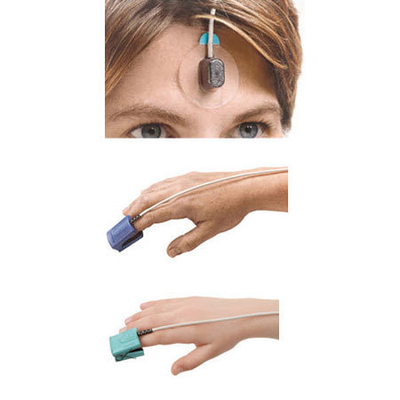
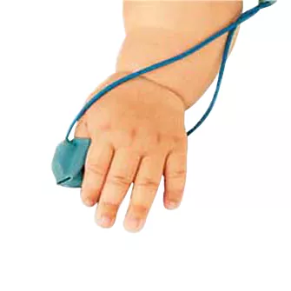
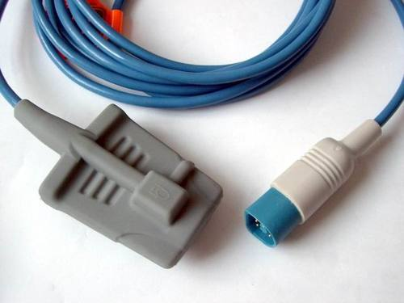
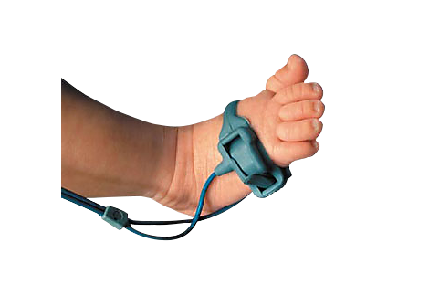

Slide 7



Slide 8
DEFINITIONS
Hypoxaemia means low levels of oxygen in the blood (low blood oxygen saturation or content).
Hypoxia is inadequate oxygen in tissues for normal cell and organ function, and hypoxia results from hypoxaemia

Slide 9
INDICATIONS
Neonate
Older children
RDS
Pneumonia
TTN
Birth asphyxia
apnea
seizures
cardiac failure
Pneumonia & Bronchiolitis
Asthma & Stridor
Cardiac failure
Seizures
Coma
Shock
Perioperative or post sedation

Slide 10
Oxygen delivery methods
Select an oxygen delivery method that suits the child’s age, size, needs, clinical condition, and therapeutic goals.
Choice of delivery method is based upon:
Degree of hypoxemia
Requirement for precision of delivery
Patient comfort
Cost

Slide 11
Common oxygen delivery methods
Nasal cannula (prongs or spectacles)
Nasal catheters
Simple Face mask
Partial rebreathing mask
Non rebreathing mask
These are low flow devices delivering 6-8 L/Min of oxygen (mixed with room air)
The FiO2 is variable - it varies with the tidal volume

Slide 12
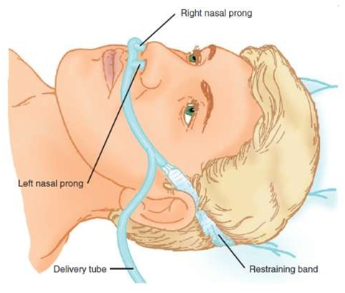
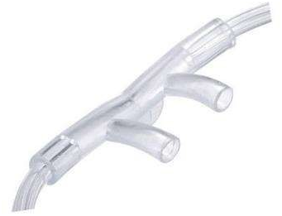
NASAL PRONGS
Consist of 2 soft prongs attached to O2 supply tubing.

Slide 13
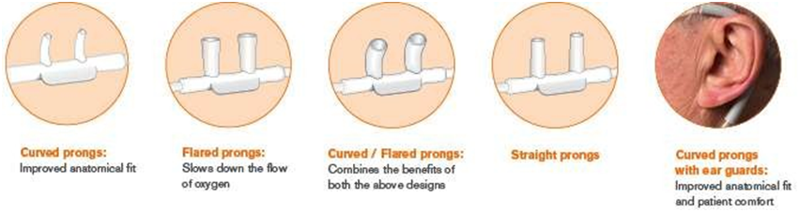
NASAL PRONGS
Available in different sizes and different prong shapes.
Size of the prongs depend on patients age, nares size and width of the nasal bridge.
The distal prong should fit well into the nostril (for premature infants: 1 mm, for infants weighing up to 10 kg: 2 mm).

Slide 14
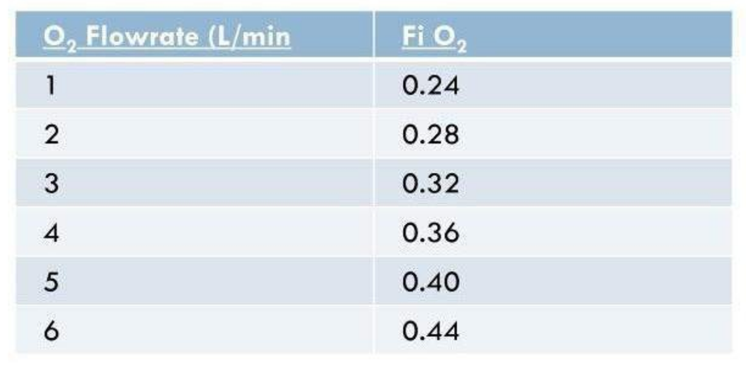
Patient of Normal ventilatory pattern- each Ltr/min of nasal O2 increases FiO2 approximately by 4%.
Eg: A patient using nasal cannula at 4Ltr/min, has an estimated FiO2 of 37%.

Slide 15
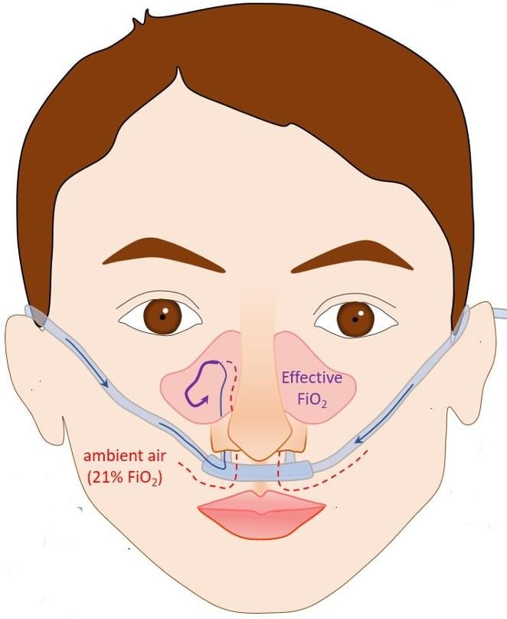
Nasal Cannula
Advantages:
  Easy to Use, light weight and comfortable.
  Patient is able to speak, eat and Drink.
  Low cost
Disadvantages:
  Can be easily dislodged.
  Cannot provide high flow rates. Rates > 6lts/min are neither useful nor comfortable
  Not very effective in patients with nasal obstruction.

Slide 16
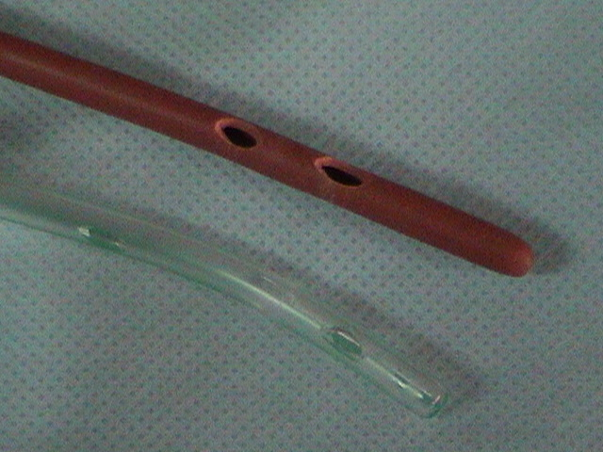
NASAL CATHETER
Single lumen catheter, which is lodged into the anterior naris by a
foam collar, inserted to just above the uvula
Recommended oxygen flow- 0.5-2 L/min.
FiO₂ 35-40%
Should be avoided in suspected nasal mucosal tear
No advantages over nasal cannula
Can get blocked with mucus
Difficult to insert; may provoke gagging
Aspiration and gastric distension if displaced into the oesophagus

Slide 17
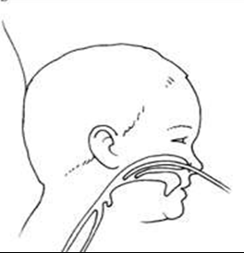
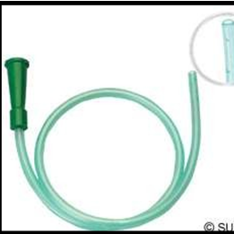
NASAL CATHETER
Length of nasal catheter to be inserted - distance from the side of the nostril to the inner margin of the eyebrow
The tip of the catheter should not be visible below the uvula.
Appropriate Size-
  Neonates and infants- 8 Fr
  Older children- 10 Fr
Cross sectional view of the position of the NG catheter

Slide 18
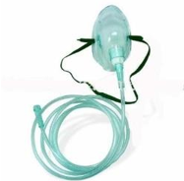
Simple Face Mask ( Hudson Mask)
The hood of the face mask acts as the reservoir- 100 to 200ml.
There is presence of open ports for the exhaled breath.
Air entrained through ports if O₂ flow through inlet does not match peak inspiratory effort.
Variable performance device, FiO₂ varies with
  O₂ input flow
  Extent of air leakage
  Patient breathing pattern.
Minimum flow of 4L/min to prevent CO₂ rebreathing

Slide 19
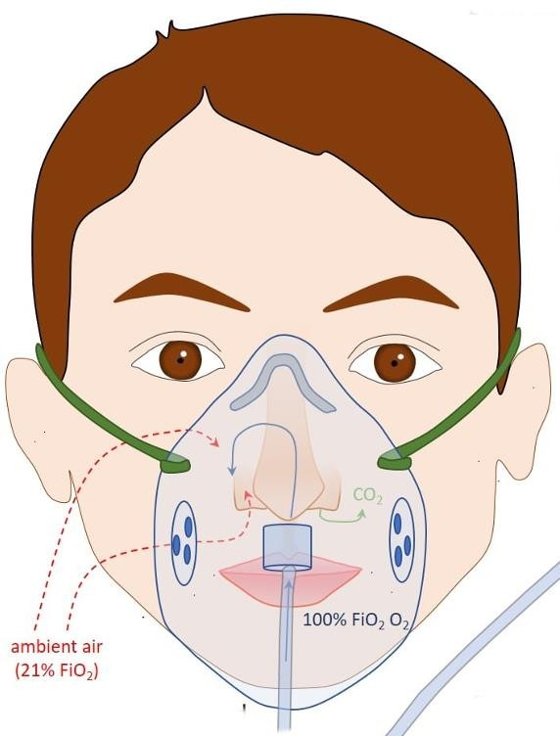
Face Mask
Input Flow Range: 5-10 L/min
FiO₂ : 0.4-0.6
Advantages:
  Moderate but variable FiO₂
  Good for patients with blocked nasal passages and mouth breathers
  Easy to apply
Disadvantages
  Proper fitting is required
  Risk of aspiration in unconscious patients
  Rebreathing (if input flow is less than 4 L/min

Slide 20
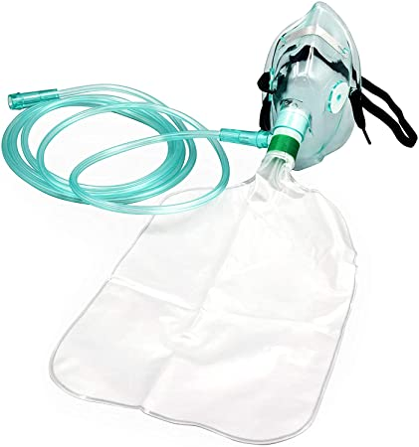
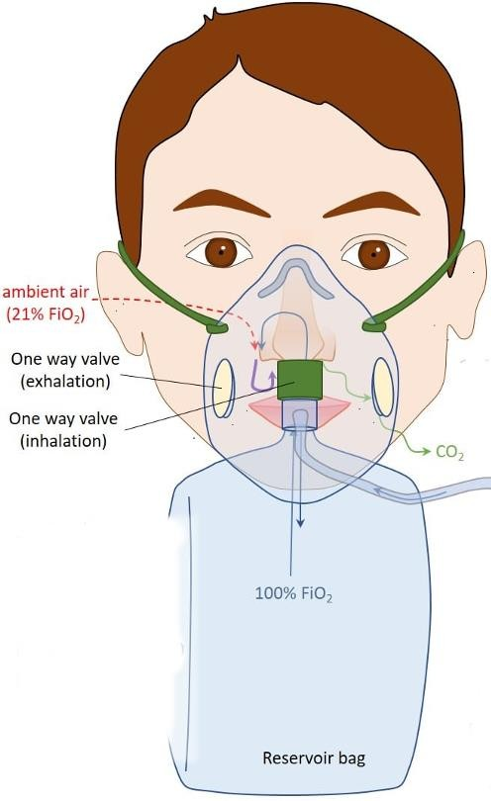
Reservoir
Reservoir System stores a reserve volume of O2, that equals or exceeds the patients Tidal Volume.
Delivers mod-high FiO2
To provide a fixed FiO2, the reservoir volume must exceed the patients tidal volume.

Slide 21
Non-Rebreather Mask
Has 3 Unidirectional Valves
Expiratory Valves prevent air entrainment.
Inspiratory Valve prevents exhaled gas flow into reservoir bag.

Slide 22
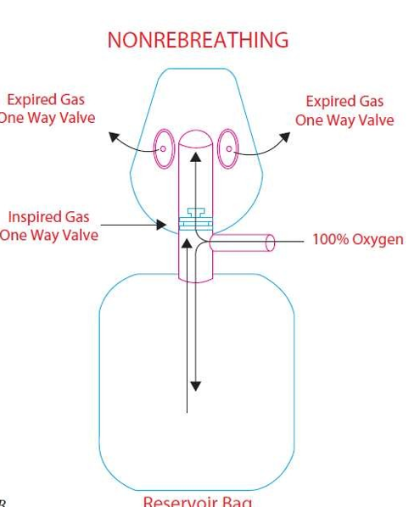
Non- Rebreather Mask
FiO₂ delivered: 0.80-0.90
Flow rates: 10-15 L/min
Ensure Bag remains inflated when applied, or may lead to suffocation.
Factors affecting FiO₂ :
  Air Leakage.
  Patients breathing Pattern.

Slide 23
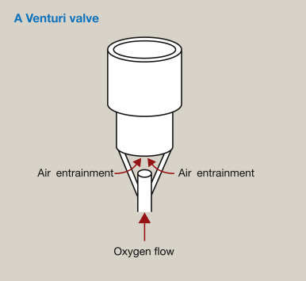
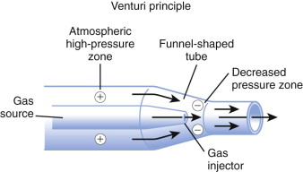
Fixed Performance Device: Venturi Mask
Bernoulli Principle
A rapid velocity of gas exiting from a restricted orifice will create sub atmospheric lateral pressure, resulting in atmospheric air being entrained into the mainstream.

Slide 24
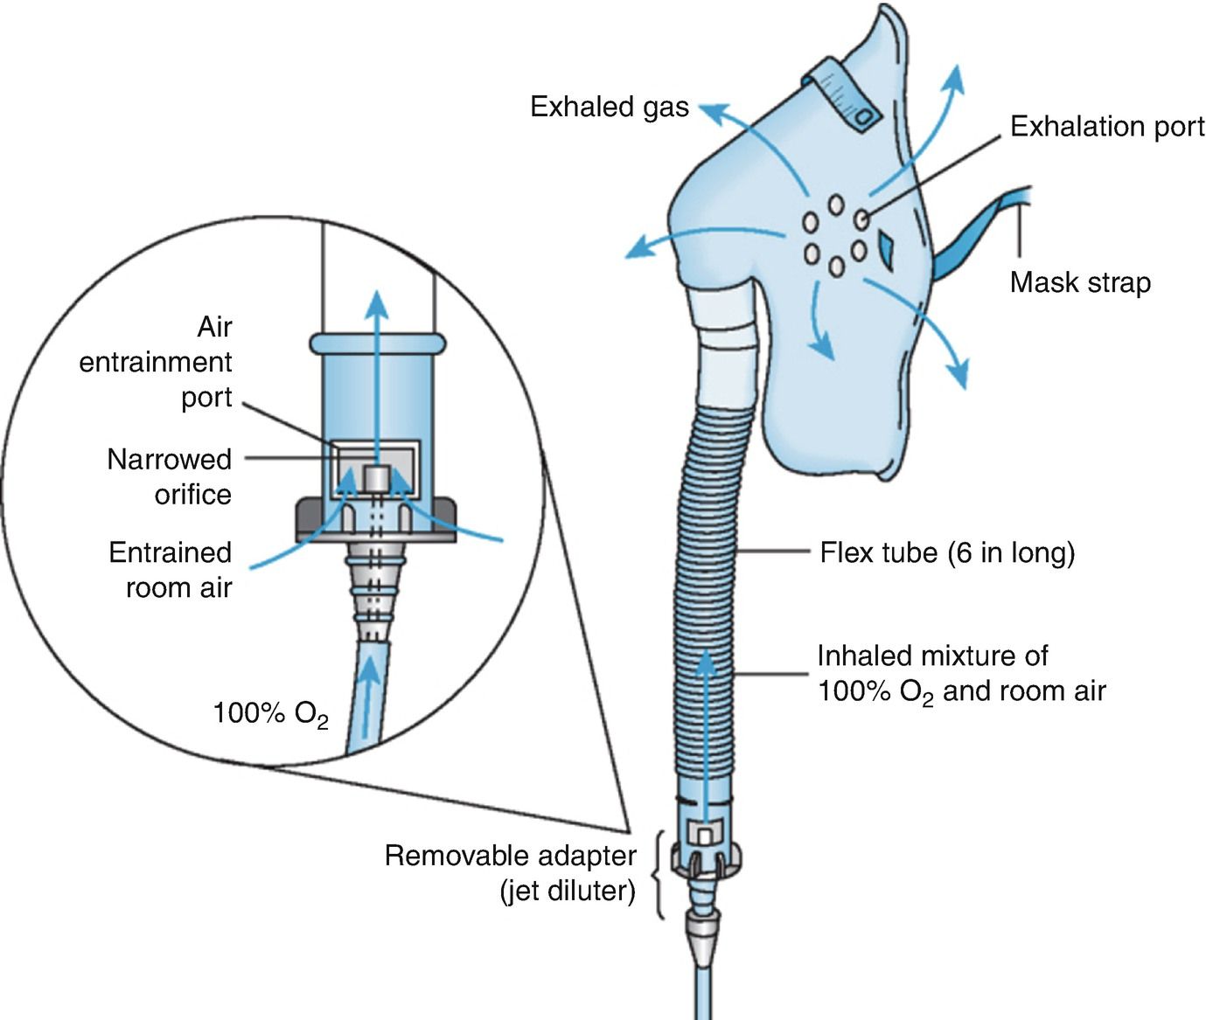
Venturi Masks
Mask consists of a jet orifice around which is an air entrainment port.
FiO₂ regulated by the size of the jet orifice and air entrainment port.
FiO₂ – Low to Moderate (0.24-0.60)
High flow fixed Performance Device.

Slide 25
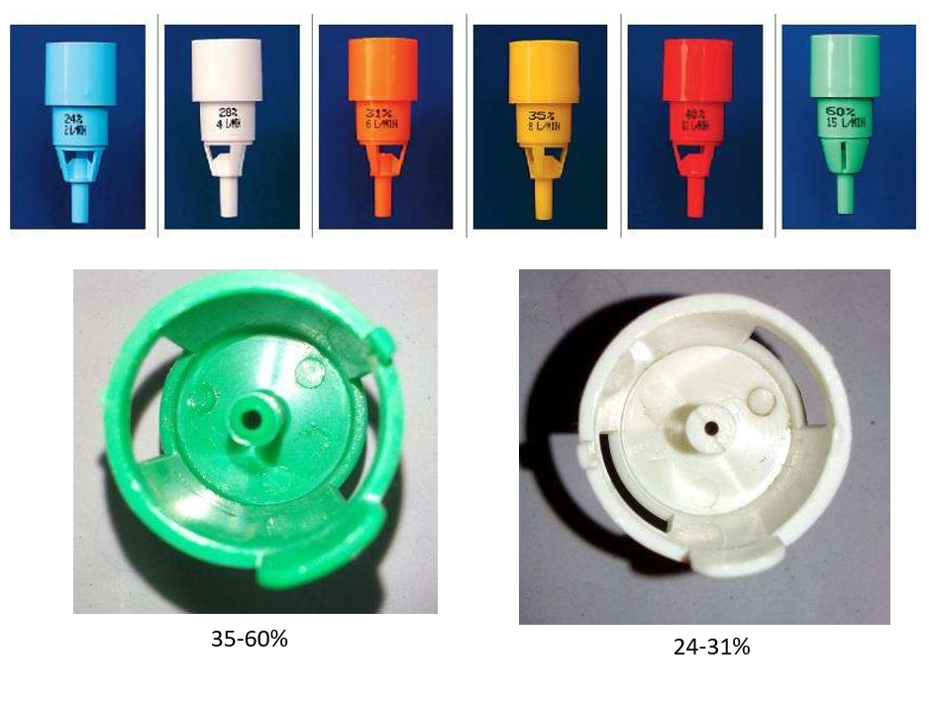
Venturi Mask

Slide 26
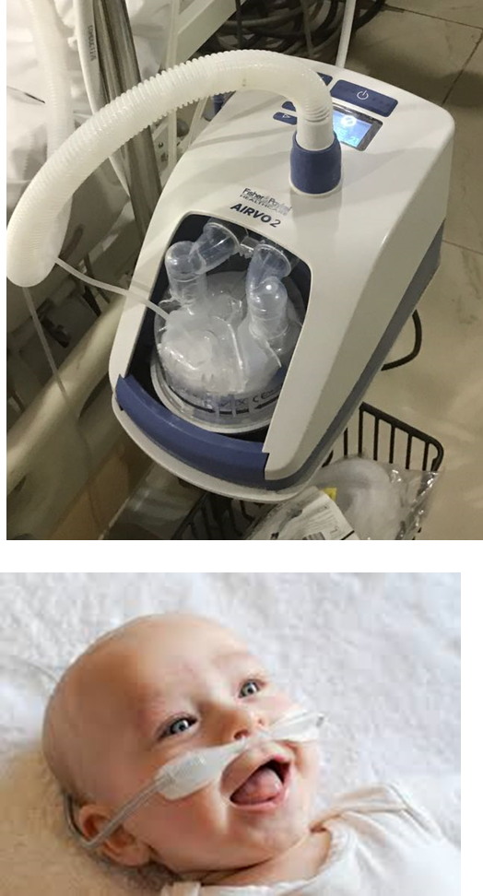
HEATED HUMIDIFIED HIGH FLOW NASAL CANULA (HHHFNC)
Air oxygen blender delivers 21-100% FiO₂
Gas heated and humidified through an active heated humidifier
Flow rates 2-60 L/min
Gas delivered via a single limb to the patient through nasal cannula of large diameter
Can deliver PEEP 4-8 cm H2O
Advantage:
Humidification
Great comfort and better tolerance
Better control of FiO₂
Better mucociliary clearance

Slide 27
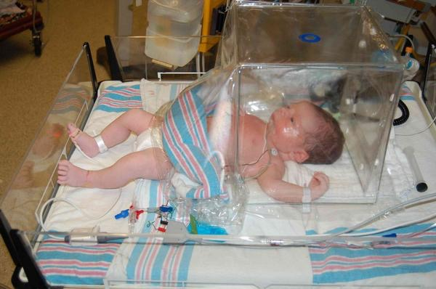
ENCLOSURE DEVICES
A canopy placed over the head and shoulders
FiO₂ – 40-50% @12-15L/min flow of O₂
Variable performance device
Provides concurrent aerosol therapy
Disadvantage
  Expensive
  Cumbersome
  Difficult to clean
  Constant oxygen leakage
  Limits patient mobility

Slide 28
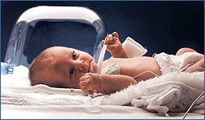
ENCLOSURE DEVICES
An oxygen hood covers only the head of the infant
Fixed performance device
FiO₂ – 40-90 %
Minimum Flow: >10L/min to prevent CO₂ accumulation
Well tolerated by infants; provides access to chest and limbs

Slide 29
In a nutshell
Device | Flow Rate (L/Min) | FiO2 (%) | Approximate time a D type O₂ cylinder will run
Nasal cannula | 1 - 6 | 24-44 | 30-60 hrs at flow 2-4 L/min
Nasal Catheter | 0.5-2 | 35-40 | 40-60 hrs at flow 2-3 L/min
Simple Face mask | 5 – 6 6 – 7 7 – 8 | 40 50 60 | 20- 24 hours 18-20 hours 14-16 hours
Mask with reservoir bag/ Partial Rebreathing Mask | 8-10 | 60-80 | 14-16hours
Non rebreathing Mask | 10-15 | 85-95 | 12 hours
HHHFNC | 2-60 | 21-100 | Variable

Slide 30
SELECTION OF DEVICE: 3Ps
3Ps are:
Purpose
Patient
Performance
Goal is to match the performance characteristics of the equipment to both the objectives of therapy (purpose) and the patient’s special needs

Slide 31
Purpose – improve arterial hypoxemia
SELECTION OF DEVICE: 3Ps
Patient factors in selection :
Severity and cause of hypoxemia
Patient age group (infant, child, adult)
Degree of consciousness and alertness
Presence or absence of tracheal airway
Stability of minute ventilation

Slide 32
3Ps: Performance based on Device
DESIRED FiO2 LEVEL | DESIRED FiO2 STABILITY
 | FIXED FiO2 | VARIABLE FiO2
LOW (< 35%) | Venturi mask | Nasal cannula Nasal catheter
MEDIUM (35%-60%) | Venturi mask | Simple oxygen mask
 | HHHFNC
HIGH (>60%) | HHHFNC | Partial rebreather mask
 |  | Non-rebreather mask
HHHFNC: Heated, humidified high-flow nasal cannula

Slide 33
ATTACHING PATIENT TO OXYGEN DELIVERY
DEVICE
Perform hand hygiene and don proper PPE.
Explain the procedure to the child and family and ensure that they agree to treatment
Place the selected oxygen device on the infant or child
If one method of oxygen delivery upsets the child, consider changing to another method
Adjust the flowmeter to deliver the desired amount of oxygen. Ensure that the liter flow is appropriate for the device.
Apply the oxygen delivery device
Discard supplies, remove personal protective equipment (PPE), and perform hand hygiene
Document the procedure in the child’s record

Slide 34
ATTACHING PATIENT TO OXYGEN DELIVERY DEVICE
Apply and secure the noninvasive oxygen delivery device, ensuring that it is the correct size.
Rationale: The correct size device ensures optimal delivery of the prescribed amount of oxygen and reduces the risk of skin breakdown.
a. If using a mask, ensure that it covers the mouth and nose but not the eyes.
b. Use adhesives to secure a nasal cannula or an elastic strap for a face mask.
Evaluate the child’s oxygen delivery device for proper fit.
a. Ensure that nasal cannula prongs remain in the nares.
b. Ensure that the infant’s head remains in the oxygen hood.

Slide 35
MONITORING & CARE OF CHILD ON OXYGEN SUPPLEMENTATION
Monitor cardiopulmonary status, including vital signs, oxygen saturation, and indicators of oxygenation and ventilation
Monitor the child’s respiratory status and need for increased or decreased oxygen therapy
Monitor the child for signs of hypercarbia (increase in CO₂)
Assess the skin frequently for breakdown
Monitor the child for signs of dry mucous membranes/ dried secretions
Provide humidification when the supplemental oxygen delivery device permits

Slide 36
EXPECTED OUTCOME
Signs of improved oxygenation and ventilation
Decrease in hypoxemia-related adverse effects
Respiratory, cardiovascular, and neurologic stability
Adequate pain control during the procedure
No local side effects

Slide 37
UNEXPECTED OUTCOME
Signs of inadequate oxygenation and ventilation
Increased work of breathing
Complications of supplemental oxygen
Increasing cardiovascular, respiratory, or neurologic compromise
Local side effects- Skin breakdown, damage to nasal septum
Inadequately managed pain and anxiety

Slide 38
DOCUMENTATION
Delivery device and amount of oxygen delivered
Respiratory status, including work of breathing and breath sounds
Vital signs including pulse rate
Pulse oximeter reading as indicated
Child’s response to supplemental oxygen
Pain assessment and related interventions
Unexpected outcomes and related nursing interventions
Child and family consent and education

Slide 39
SAFETY AND COMPLICATIONS
How much Oxygen is safe?
100% - not more than 12hrs
80% - not more than 24hrs
60% - not more than 36hrs
Potential complication of oxygen therapy:
Oxygen toxicity
Depression of ventilation
Retinopathy of Prematurity
Absorption atelectasis
Fire hazard
Goal should be to use lowest possible FiO₂ compatible with adequate tissue oxygenation.

Slide 40
TAKE HOME MESSAGE
Oxygen is a drug to be used judiciously
Knowledge and identification of oxygen delivery systems are important
Consider daily for removal of oxygen if not required
Checklist for oxygen therapy-
  Right Indication
  Right dose
  Right device
  Right duration
  Monitor danger and complications

Slide 41
TAKE HOME MESSAGE
Oxygen delivery devices- include nasal prongs, nasopharyngeal catheters, rebreathing and non- rebreathing face masks and enclosure devices.
Nasal prongs and nasopharyngeal catheters are the most efficient means for delivering oxygen.
Nasal prongs are the preferred oxygen delivery method in most circumstances for optimal balance between safety, efficacy and efficiency.
Humidification is essential when cold oxygen is delivered from a cylinder through a nasopharyngeal catheter or when high oxygen flows are used.
Humidifier reservoirs should be cleaned regularly to avoid bacterial contamination.

Slide 42
THANK YOU

