Slide 1


Reaching Impact, Saturation, and Epidemic Control (RISE): POCUS in COVID-19
Notes:
May add the MOH logo if required/requested by host country government

Slide 2
Learning Objectives
To learn the technique for performing pulmonary ultrasound.
To identify normal pulmonary ultrasound finding.
To identify the common pulmonary ultrasound findings in various pulmonary pathologies ( effusion, Pneumothorax, Acute Interstitial syndrome and pneumonia)
To identify the common pulmonary ultrasound findings in patient with COVID-19.

Slide 3
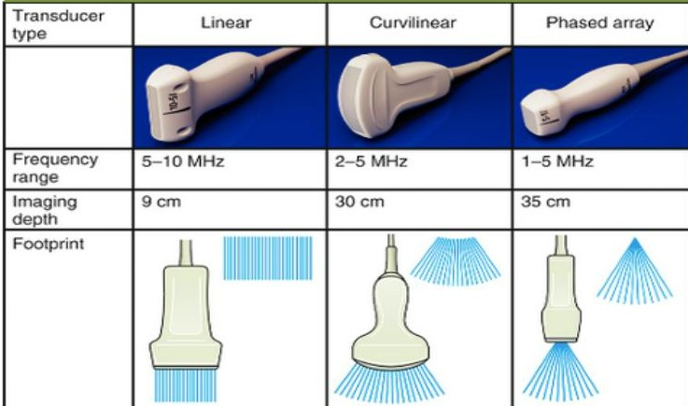
Transducers

Slide 4
Tansducer Type | Pros | Cons
Curvilinear | Ideal for Lung Ultrasound Good Combination of Resolution and Depth Large field of view to see multiple spaces | Large foot print can make it difficult to visualize through a single rib space. May need to switch for cardiac imaging Near field resolution may not be as optimal as with linear probe.
Phased Array | Deep penetration Small footprint to examine between single intercostal space Useful when also doing cardiac exam | Difficult to get precise definition of pleural line Near field resolution not as optimal as linear probe
Linear Probe | High resolution, resulting in precise definition of pleural line. Great for evaluating pleural line and subpleural consolidations | Due to the higher frequency, linear transducers are not ideal for visualizing structures past 6 cm Might miss pleural effusions and deep consolidations

Slide 5
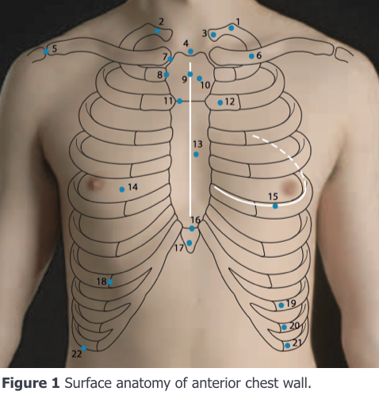
Lung Examination
Patient position: Usually Supine
Transducer Type:
Linear: For superficial Structures
Curvilinear: Deeper structures
Procedure
Always examine both lungs.
Probe is placed perpendicular on the chest wall with the pointer oriented cranially.
Lawn mower technique

Slide 6
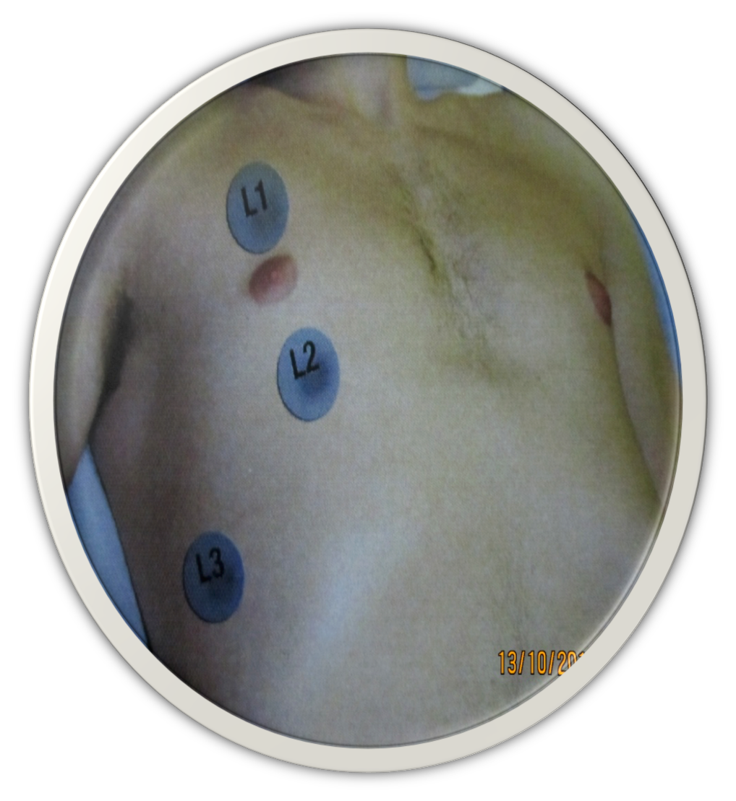
Lung Examination Zones
Lung Zone 1/ L1
2nd 3rd and 4th intercostal spaces, anterior chest wall.
Lung Zone 2/L2
5th- 8th intercostal spaces, anterior chest wall
Lung Zone 3/L3
4th -10th intercostal spaces between the anterior and posterior axillary lines.

Slide 7
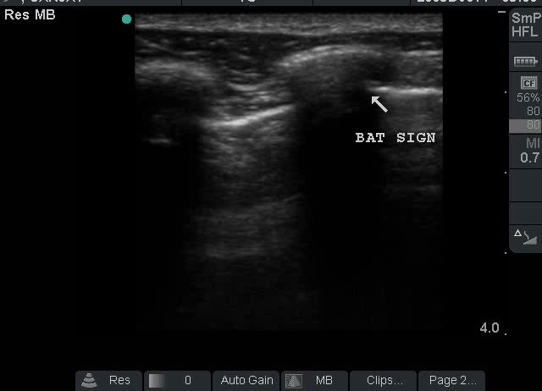
Lung Signs
Bat Sign/Normal
Transducer at L1, with the marker Cephalad
The sign is formed by shadows of two ribs and the pleural line (looks like a bat flying towards you)
Try to obtain this image initially, to avoid artifacts

Slide 8
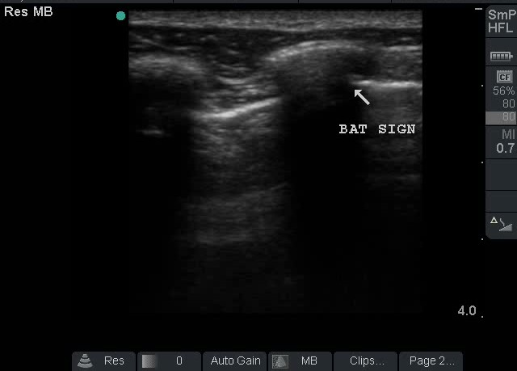



Slide 9
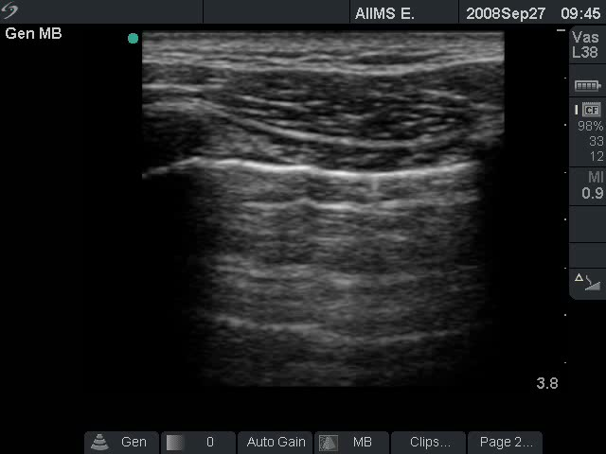
Structures to be Identified
Skin
Subcutaneous tissue
Muscular layer
Ribs on either side (cortex with shadowing) with Intercostal layer in between
Pleura

Slide 10
Lung Signs (Cont.)
Lung sliding (Normal)
Movement of the Pleura with breathing will generate the “ Lung Sliding” sign
Also called as the marching ant sign.

Slide 11
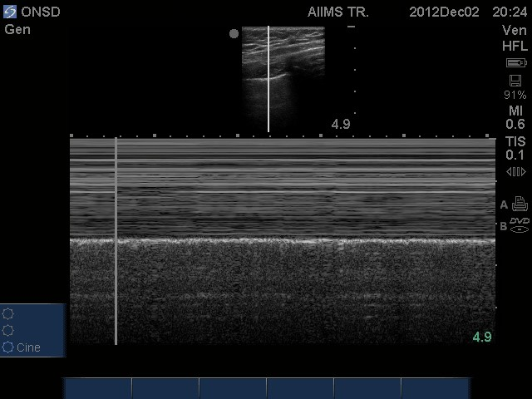
Lung signs (cont.)
Lung Sliding (cont.)
Lung sliding can sometimes be better evaluated with the M Mode generating the “Sea Shore” sign.
The presence of the lung sliding and the sea shore sign, mostly rules out pneumothorax.

Slide 12
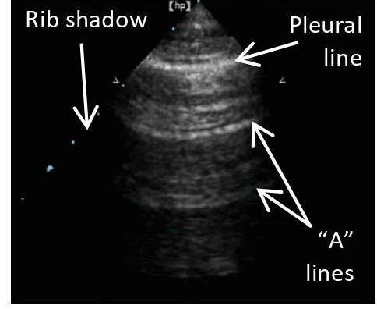
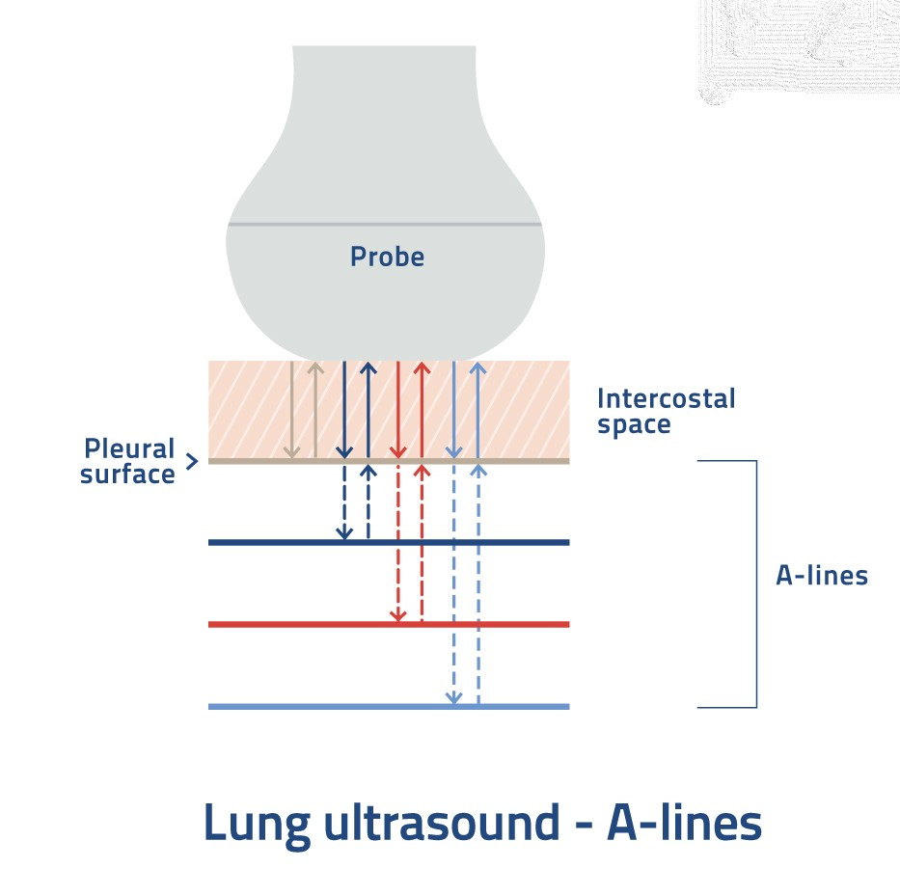
Lung Signs (cont…)
A lines (Normal)
Horizontal, echogenic reverberation artefacts that occur beneath the pleural line.
Indicate dry interlobular septa
https://www.bcfultrasound.com

Slide 13
Pathologies
Pleural effusion/hemothorax
Pneumothorax
Acute Interstitial Syndrome
Pneumonia

Slide 14
Pleural Effusion/ Hemothorax
Patient Position
Supine
Pulmonary regions
Lung Zones L3, L4
Transducer Type and Placement
Phased Array or curvilinear
The footprint is perpendicular to the skin with the marker pointing cephalad

Slide 15
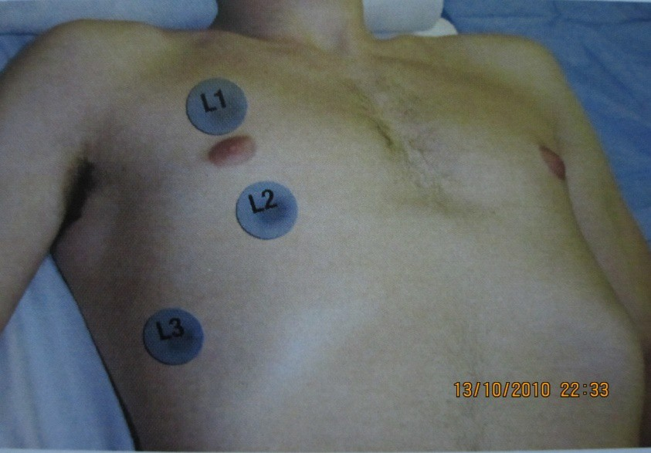
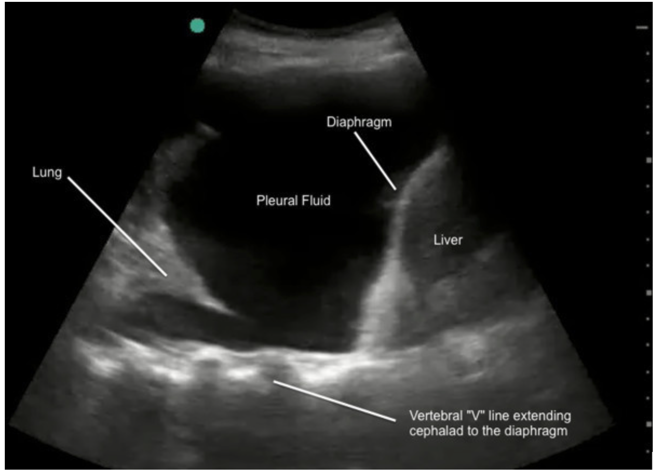
Pleural Effusion/ Hemothorax
Start at the lower edge of Zone 3 and slide the transducer cephalad to detect the interface between the Diaphragm and Pleural space
Structures to be identified
Chest wall
Diaphragm
Lung
Pleural Effusion
Liver or Spleen

Slide 16
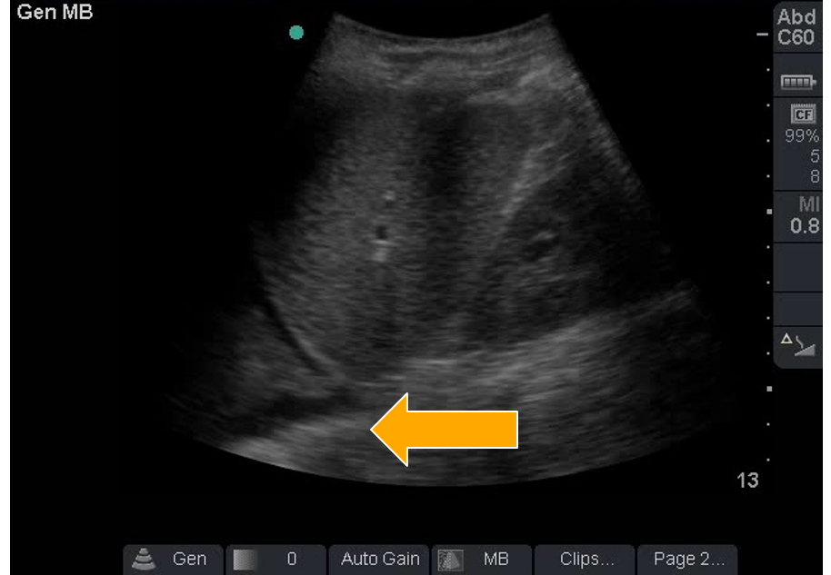
Pleural fluid assessment
THORACIC SPINE SIGN

Slide 17
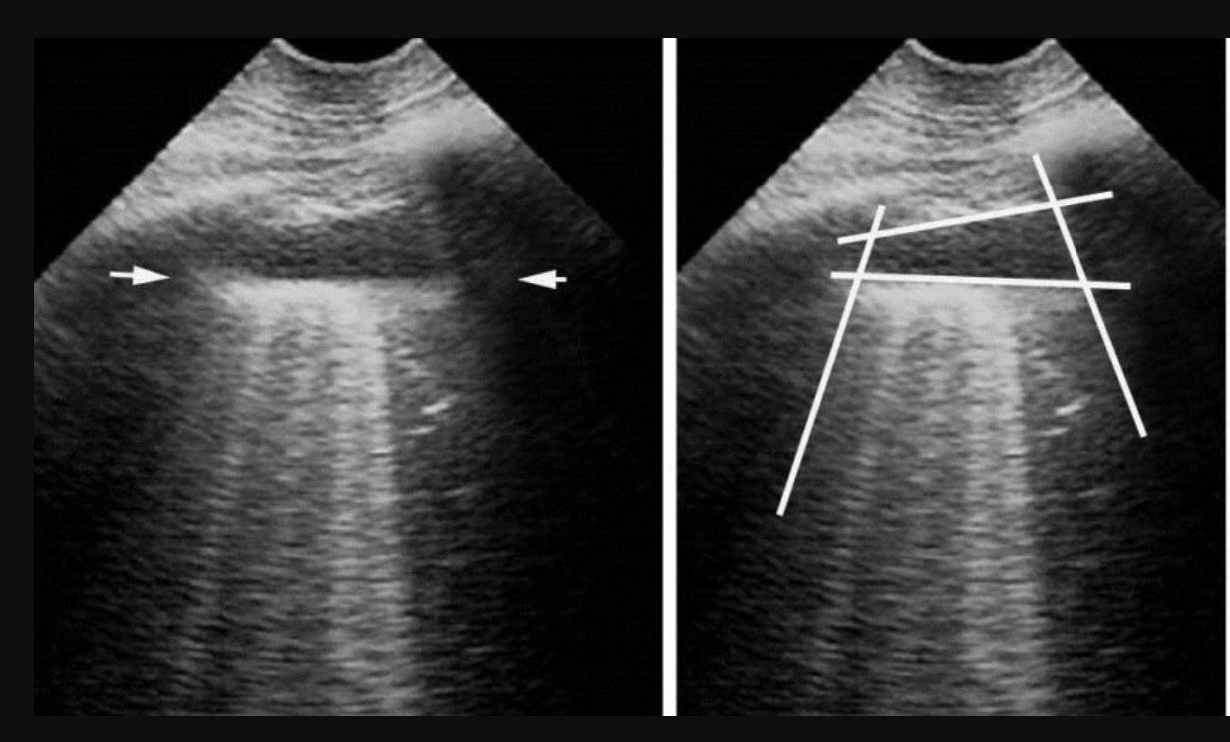
Quad Sign

Slide 18
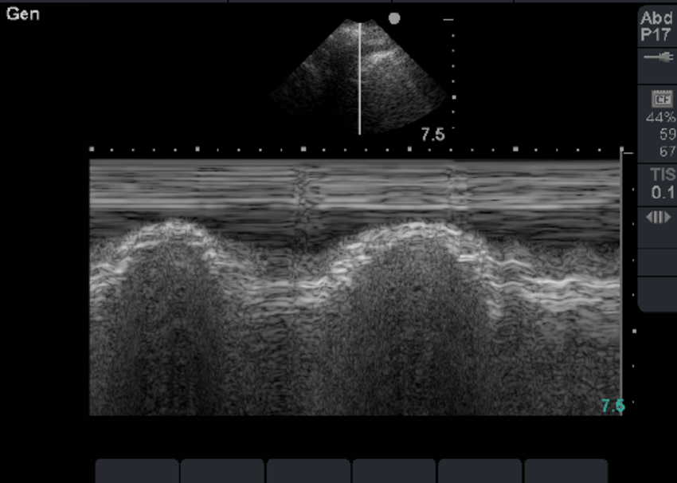
Sinusoidal Sign

Slide 19
Pleural Effusion
Fluid Volume
Measure the fluid depth at the lung base or the level of the 5th intercostal space
Measurement starts 3 cms from the inferior pole of the lung to the chest wall
>5cm fluid thickness indicates pleural effusion >500 ml

Slide 20
Pneumothorax
CXR vs. USG
PTx is misdiagnosed with CXR in 30-40% cases
Half of radio-occult PTx yield tension PTx
Bedside USG is more sensitive than CXR for diagnosis of PTx
9 comparative trials
Lichtenstein et al. Crit Care Med 2005; 33:1231–1238 Rowan et al. Radiology 2002; 225:210 –214 Kirkpatrick et al. J Trauma2001; 50:750 –752

Slide 21
Pneumothorax
Transducer Placement:
Perpendicular to the skin, with marker pointing cranially in zones L1, L2 and L3
Examine all zones while sliding the probe from one zone to another (Lawn Mower Technique)
Structures to be identified:
Ribs, Intercostal area, Pleural, lungs.
Bat sign

Slide 22
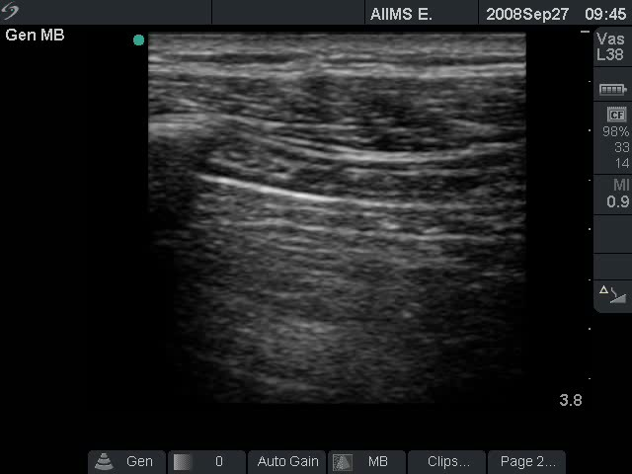
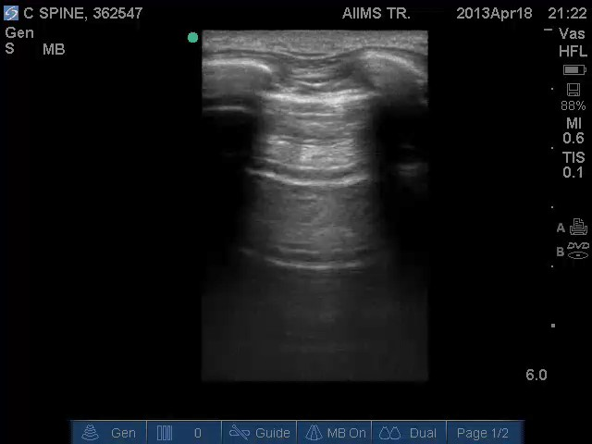
Absent Lung Sliding Sign

Slide 23
Lung Signs (cont.)
Absent Sliding
Can be absent in pneumothorax, atelectasis, pleurodesis, parietal emphysema or any cause that interrupts normal pleural movement

Slide 24
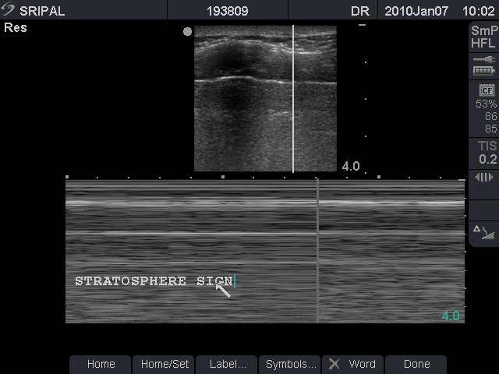
Stratosphere Sign

Slide 25
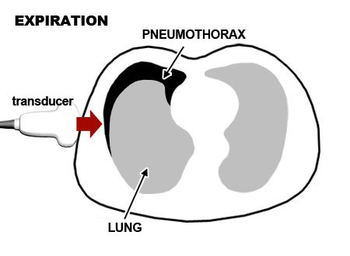
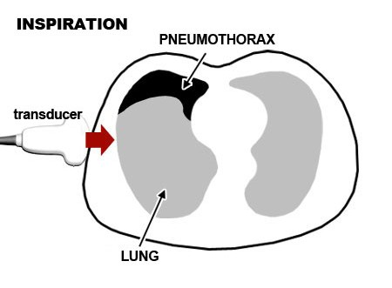
Pneumothorax
Lung Point
A localized transition point from intrapleural air (Pneumothorax artifact) to intraparenchymal air- 100% specific for pneumothorax.
The transition from Seashore sign to Stratosphere sign on the M-Mode

Slide 26
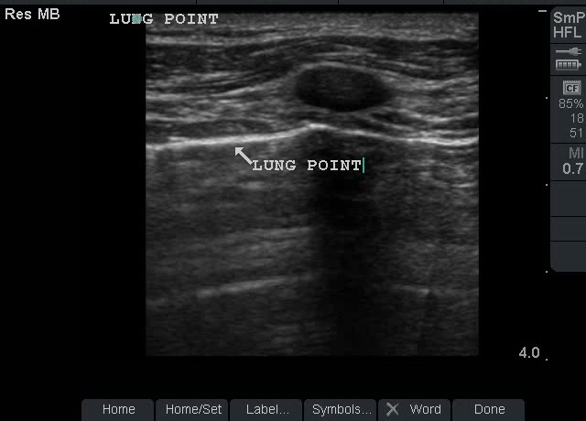
Lung Point

Slide 27
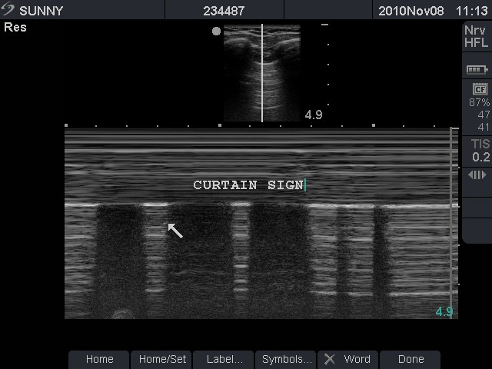
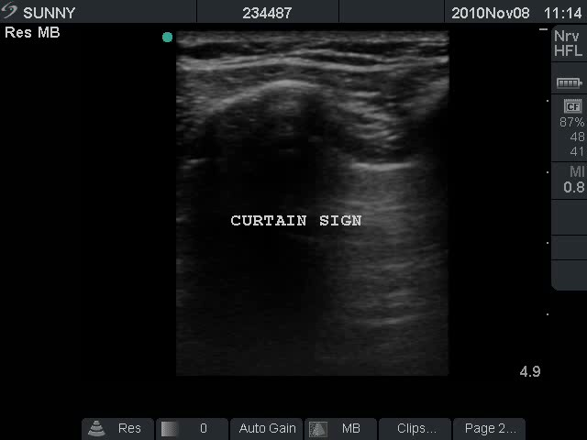

Curtain Sign

Slide 28
Acute Interstitial Syndrome (AIS)

Slide 29
Acute Interstitial Syndrome
Transducer Placement:
Perpendicular to the skin, with marker pointing cranially in zones L1, L2 and L3
Examine all zones while sliding the probe from one zone to another (Lawn Mower Technique)
Structures to be identified:
Ribs, Intercostal area, Pleural, lungs.
Bat sign

Slide 30
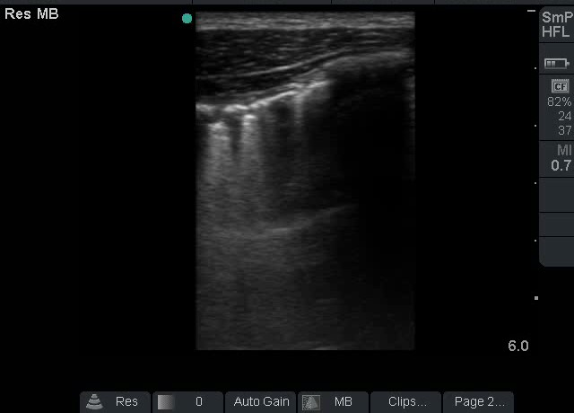
Comet Tail Artifact/B-line
Laser Like vertical lines
Extending from the Pleural line upto the edge of screen without fading.
Synchronized with lung sliding
Overshadow the A lines.

Slide 31

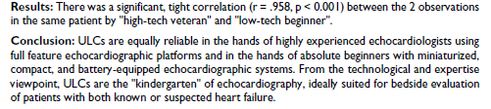

Slide 32
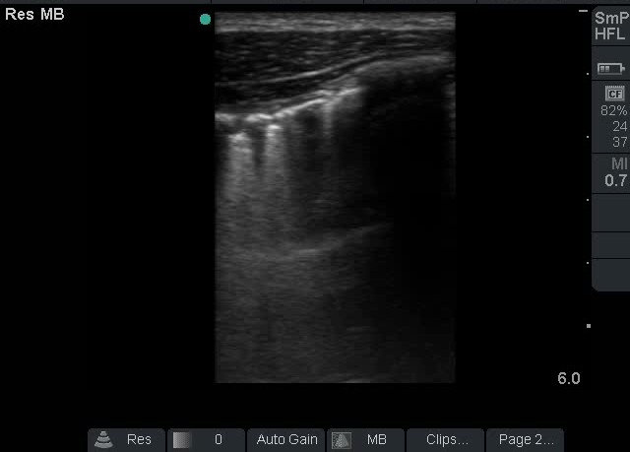
B-Line

Slide 33
Pneumonia
Patient Position
Supine
Pulmonary regions
Lung Zones L3, L4
Transducer Type and Placement
Phased Array or curvilinear
The footprint is perpendicular to the skin with the marker pointing cephalad

Slide 34
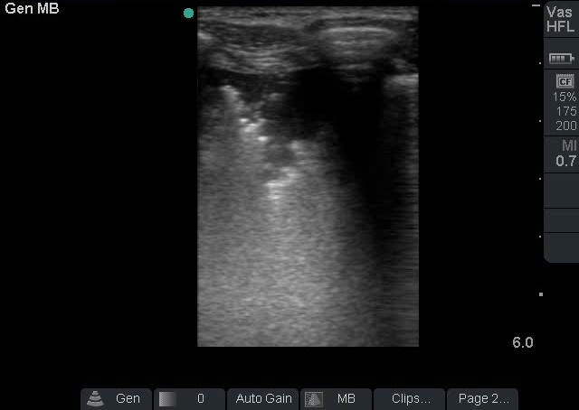
Pneumonia
Early pneumonia maybe seen as localized B-lines
Bacterial pneumonia typically displays ‘hepatization’ with increased consolidation. ( Tissue like sign)
Other visible signs:
Air Bronchogram
Shred Sign

Slide 35
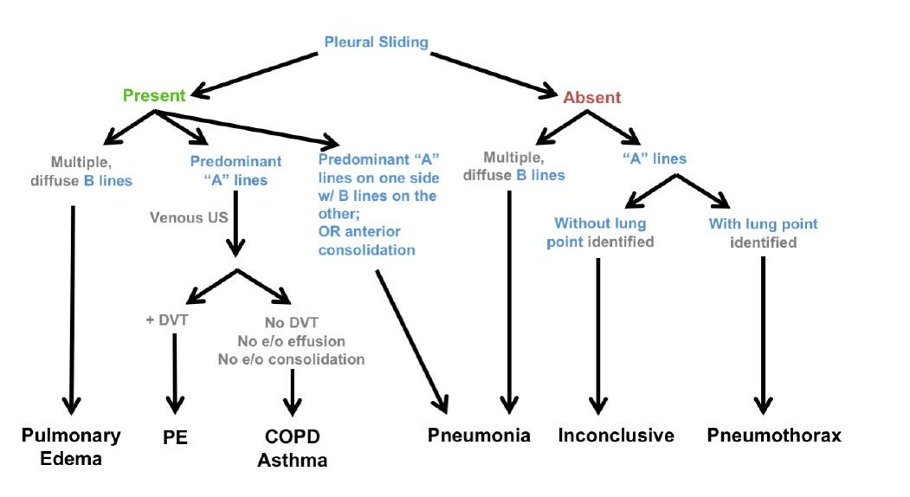
Summary
Assessment of a patient with Breathlessness

Slide 36
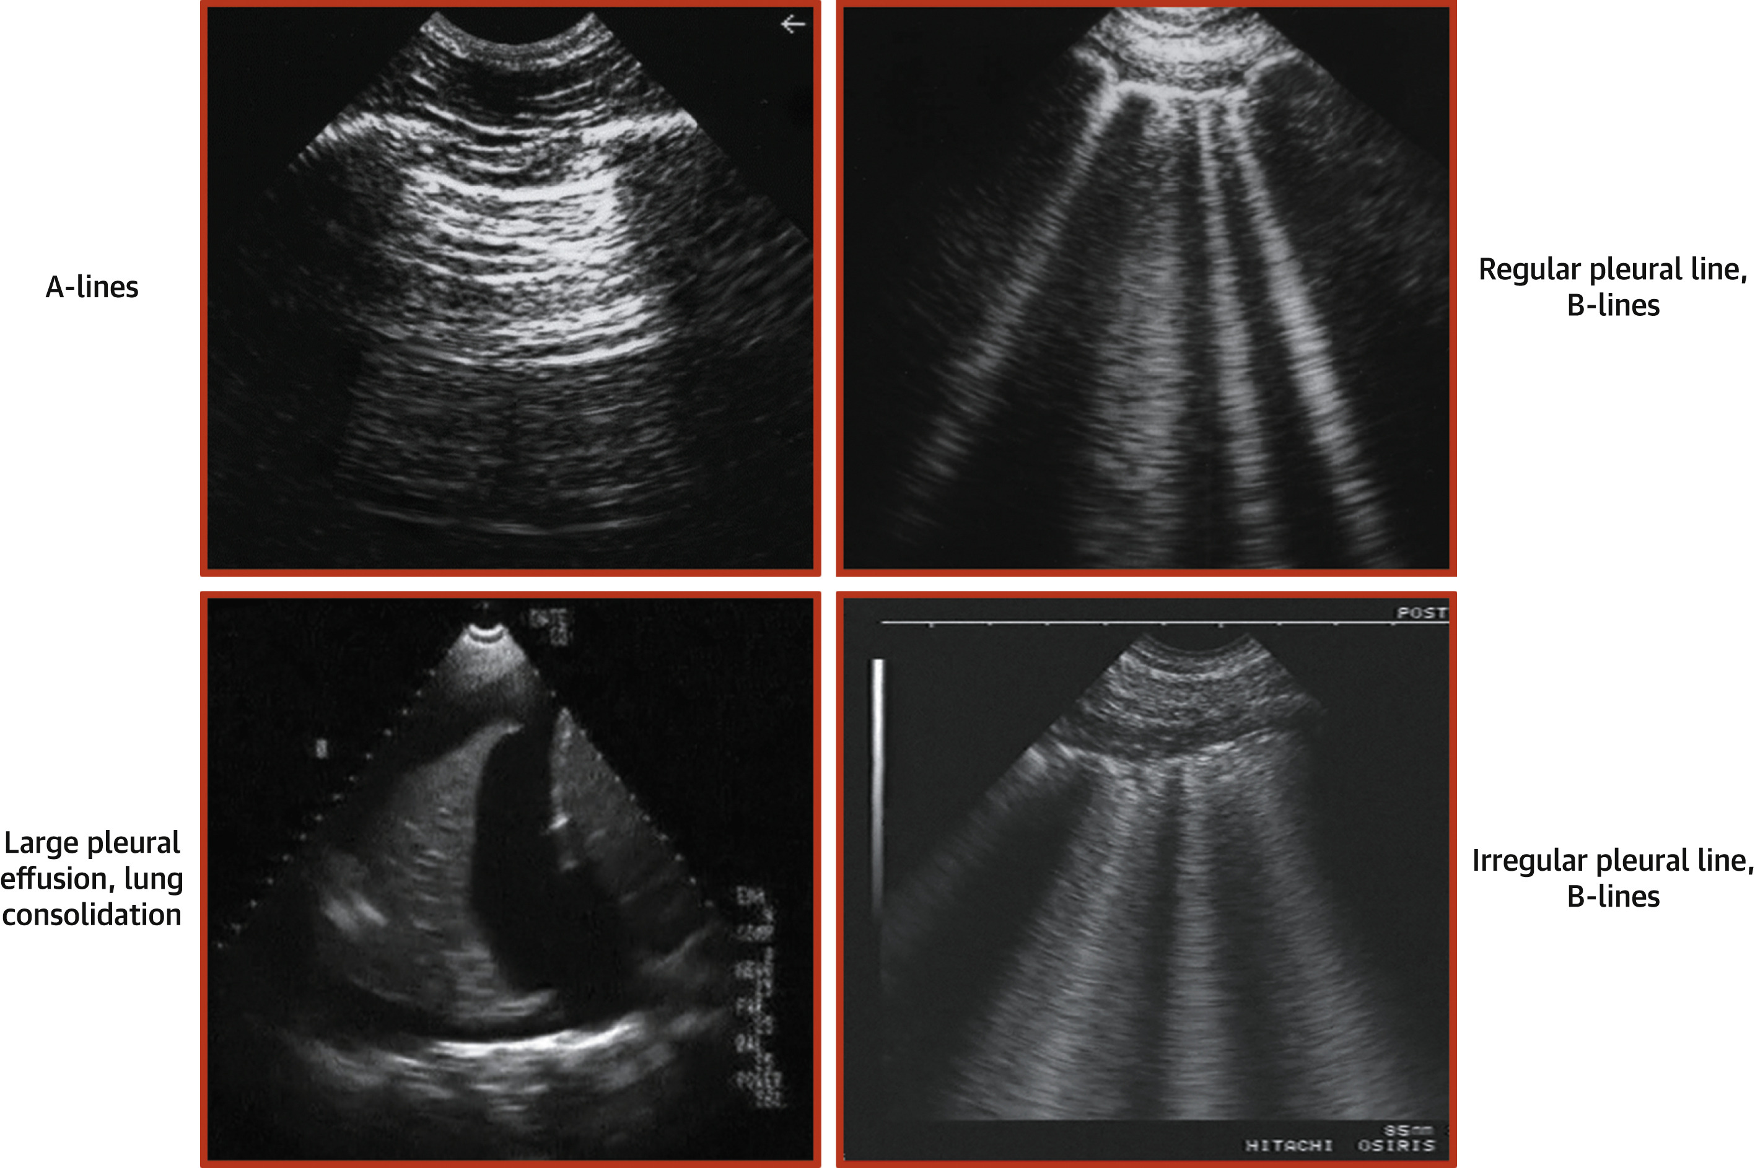
Summary

Slide 37
POCUS in COVID 19 pandemic

Slide 38
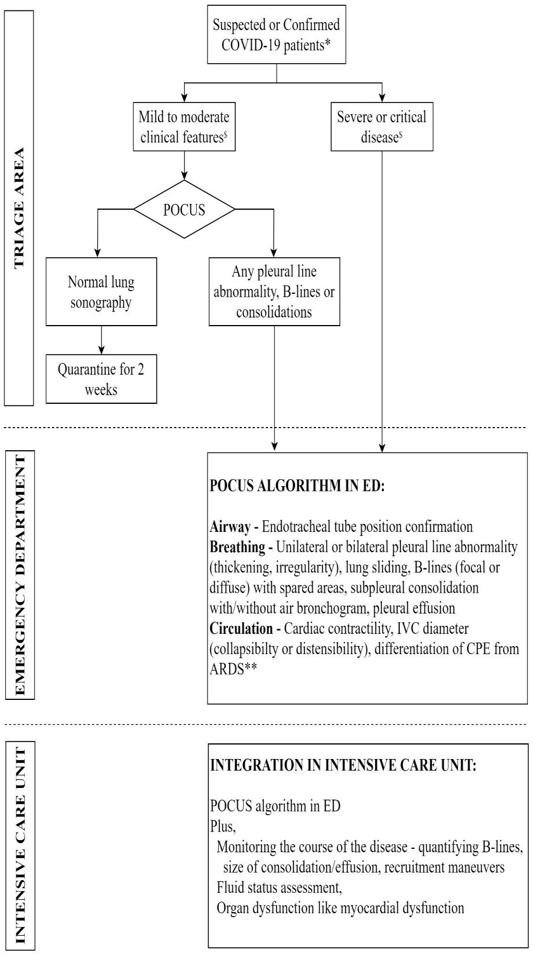

Slide 40
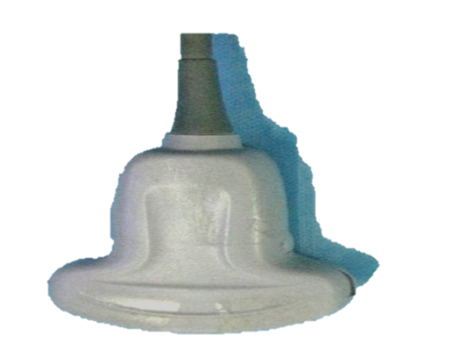
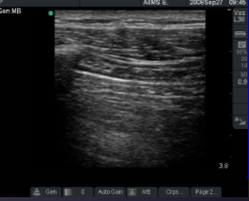
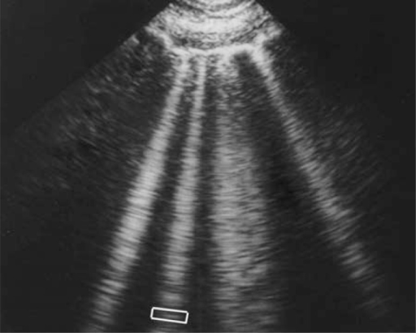
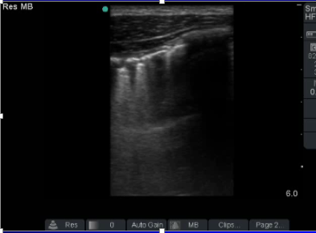
Triage area
Normal scan
Abnormal scan
“A” profile
“B” profile
Pleural shredding
Shift to Emergency Department
Quarantine

Slide 41
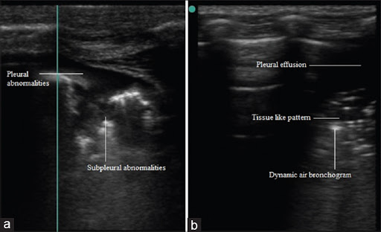
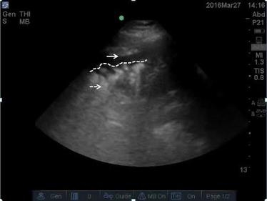
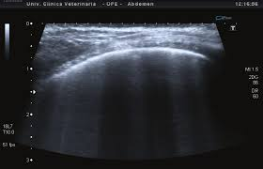
Lung ultrasound findings
Pleural line irregularities
Patchy sub-pleural consolidation
Tissue like patterns with static or dynamic air-bronchogram
Normal pleural line
Disrupted pleural lines

Slide 42
Characteristic findings
Thickening of the pleural line with pleural line irregularity
B lines in a variety of patterns including focal, multifocal, and confluent
Consolidations in a variety of patterns including multifocal small, non-translobar, and translobar with occasional mobile air bronchograms
Appearance of A lines during recovery phase
Pleural effusions are uncommon

Slide 43


Slide 44
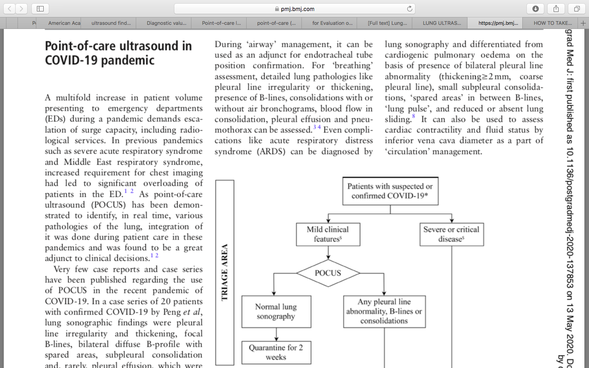
BMJ-Postgraduate Medical Journal

Slide 45
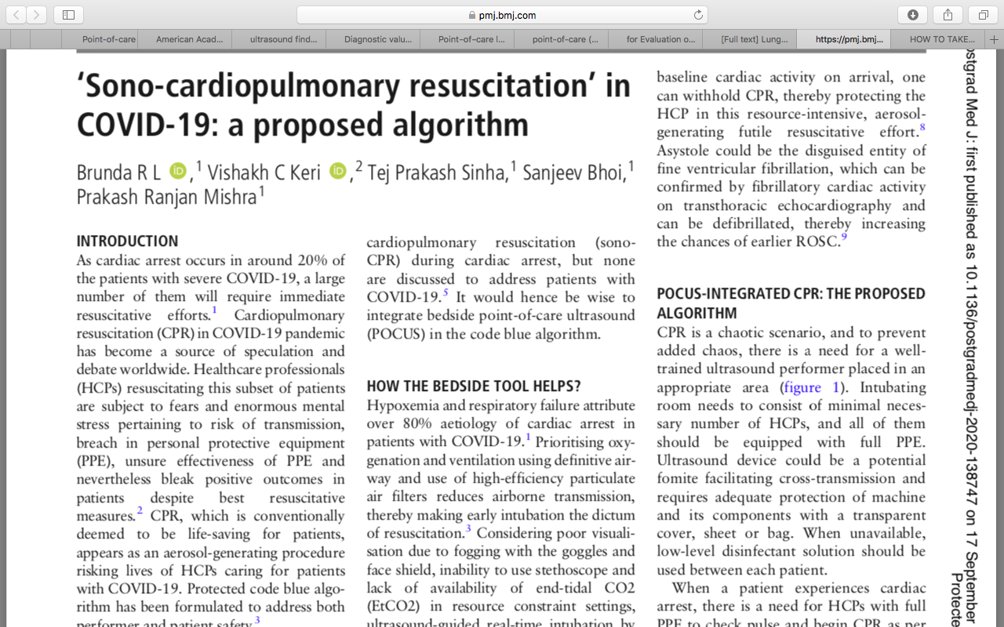
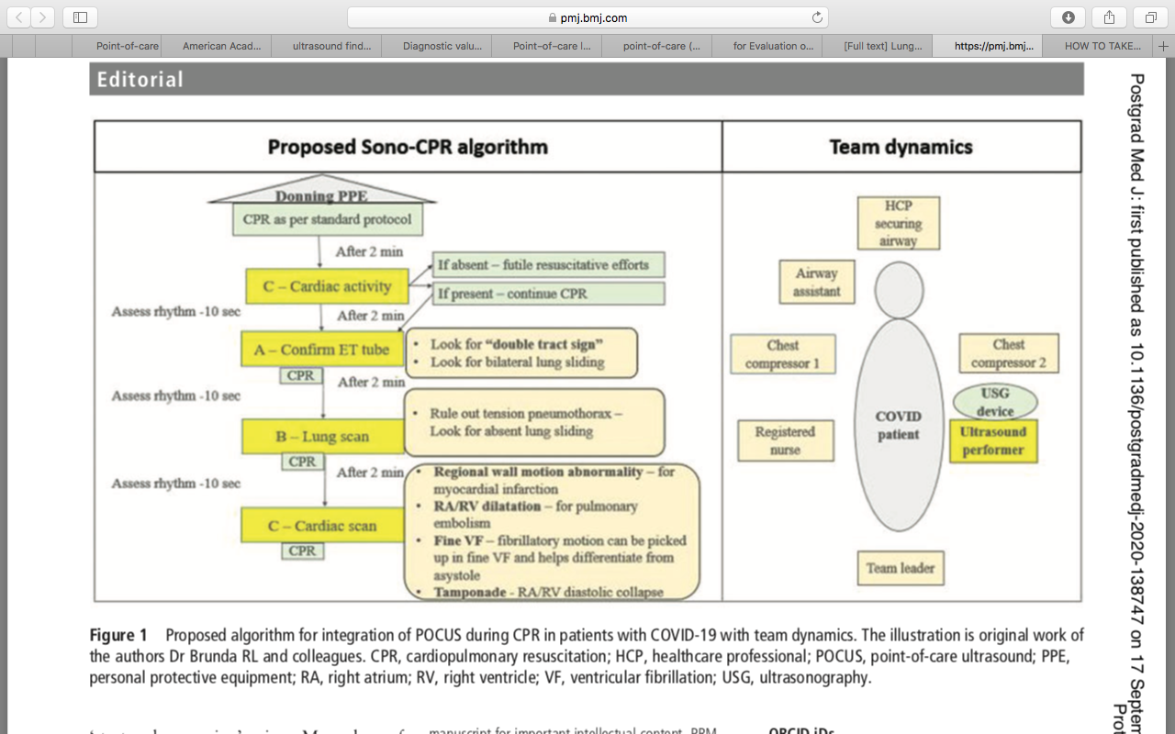
BMJ-Postgraduate Medical Journal

Slide 46
Thank You!
This presentation was made possible with support from the United States Agency for International Development funded RISE program, under the terms of the cooperative agreement 7200AA19CA00003. The contents are the responsibility of the RISE program and do not necessarily reflect the views of USAID or the United States Government.​

