Slide 1
Mechanical Ventilation

Slide 2
Learning Objectives
To understand the Basics of Respiration
Explore Indications and goals of Mechanical Ventilation
Be Familiar with normal parameters of Mechanical Ventilation
Overview Modes of Mechanical Ventilation
Discuss Complications of Mechanical Ventilation

Slide 3
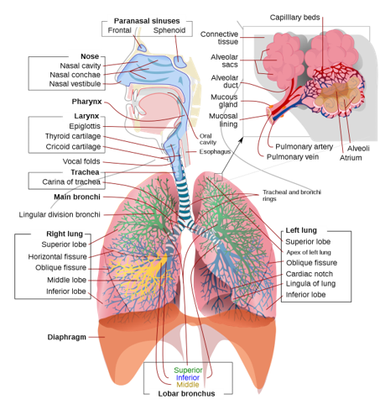
Respiratory Anatomy
Image: Wikimedia commons

Slide 4
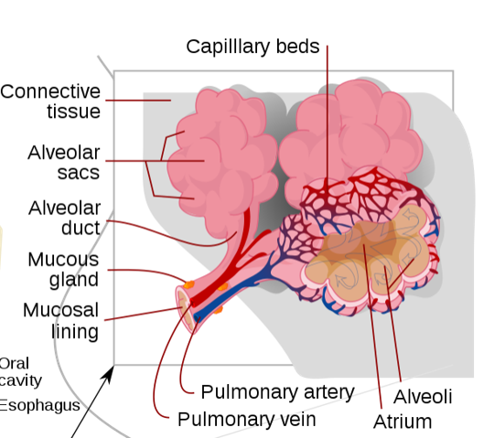
Respiratory Anatomy
Image: Wikimedia commons
Notes:
Important to highlight the alveoli as the centers for gas exchange

Slide 5
Mechanism Of Breathing
Brainstem Control
Chemo-receptors
Diaphragm contraction and chest wall expansion
Increased Intrathoracic Volume
Negative Intrathoracic Pressure
Air flows from high to low pressure
Negative pressure Ventilation

Slide 6
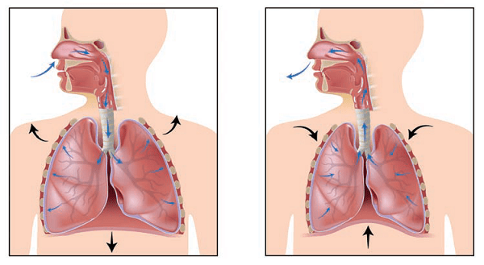
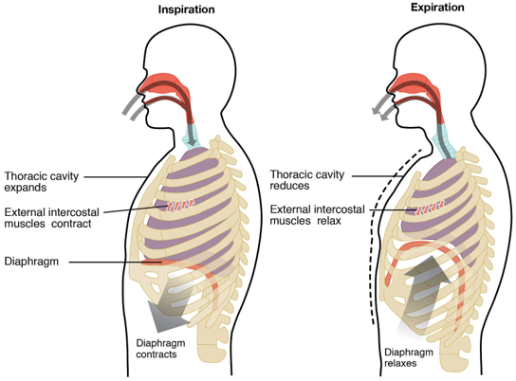
Mechanism Of Breathing

Slide 7
Introduction
Mechanical Ventilation is indicated when the patient’s spontaneous ventilation is inadequate to sustain life.
The ventilator delivers airs, usually with an elevated oxygen content, to a patients lungs via an endotracheal tube to facilitate the exchange of oxygen and carbon-dioxide.

Slide 8
Goals and purpsoes
Mechanical ventilation alone does not treat or reverse the underlying
pathology
Improve gas exchange
Relive respiratory distress
Improve pulmonary mechanics
Permit lung and airway healing
Reverse hypoxemia
Relieve acute respiratory acidosis
Reverse respiratory muscle fatigue
Prevent and reverse atelectasis
Improve lung compliance

Slide 9
Indications
Indications for Ventilatory Support
Airway Protection
Hypoxemic Respiratory Failure
Hypercapnic Respiratory Failure
Combination of both (Hypoxemia+ hypercapnia)
Cardiovascular Insufficiency (sepsis, shock, congestive heart failure)

Slide 10
Respiratory Mechanics
Ventilation can occur only when sufficient pressure is applied to overcome two forces that oppose the movement of the respiratory system.
Elastic Forces (quantified as compliance)
Viscous Forces (quantified as resistance)
05

Slide 11
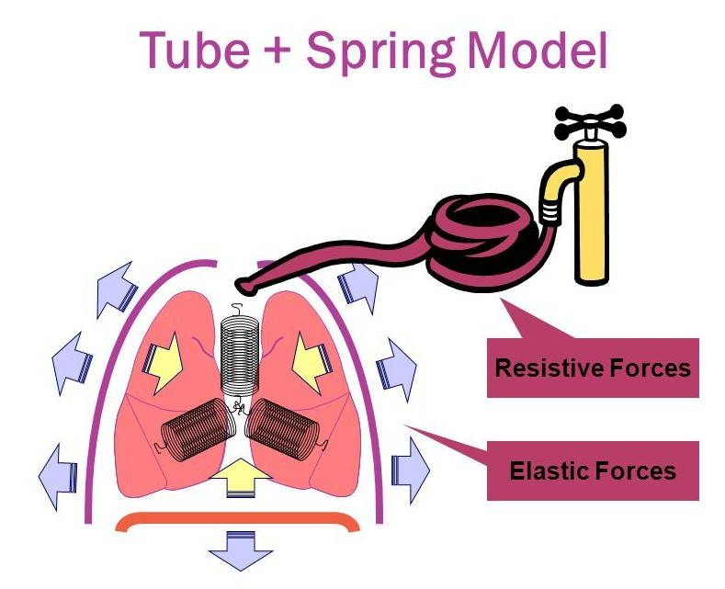
Respiratory Mechanics
06

Slide 12
Airway Pressure
Peak inspiratory pressure: The pressure used to deliver the tidal volume by overcoming nonelastic (airways) and elastic (lung parenchyma) resistance.
Plateau pressure: The pressure needed to maintain lung inflation in the absence of airflow.
07

Slide 13
Static and Dynamic Pressure
Pressure
PIP
Flow-Resistive
Pressure difference (P resistive)
Pplat
Alveolar Distending (recoil)
Pressure difference (P distension)
PEEP
Time
08

Slide 14
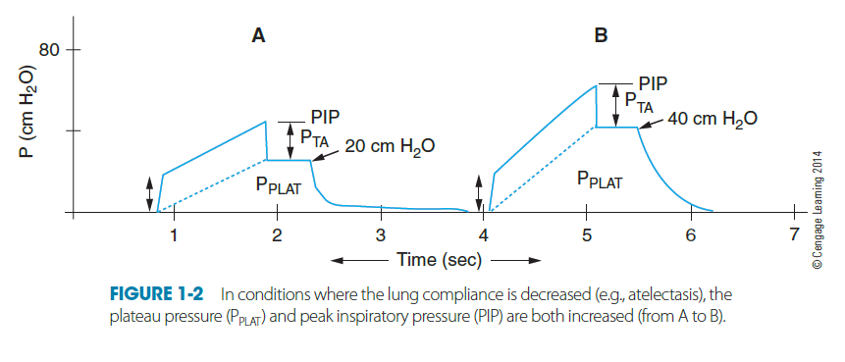
Compliance
Lung compliance is volume change (lung expansion) per unit pressure change (work of breathing), and it is calculated by C = DV/DP
When lung compliance is decreased (eg. atelectesis), both plateau pressure (Pplat) & peak pressure (PIP) are increased.
10

Slide 15
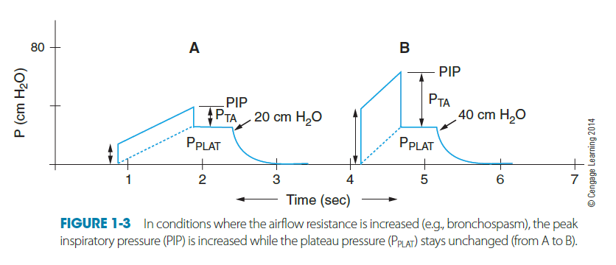
Compliance
20
When airway resistance is increased (eg. bronchospasm), PIP is increased but Pplat remains unchanged.
11

Slide 16
Compliance
Clinical Conditions that decrease the Compliance
Type of Compliance | Clinical Conditions
Static Compliance | ARDS Atelectasis Tension Pneumothorax Obesity Retained secretions
Dynamic Compliance | Bronchospasm Kinking of ET tube Airway onbstruction

Slide 17
Invasive Positive Pressure Ventilation
Full ventilatory support: the ventilator provides all the energy necessary to maintain effective alveolar ventilation
Partial ventilatory support: the ventilator provides partial support and the patient participates in work of breathing to help maintain effective alveolar ventilation
15

Slide 18
Types of Breath Delivery
Controlled
  Ventilator controls the timing, tidal volume or both
Spontaneous
  Patient controls the timing and the tidal volume
Assisted
  Characteristics of both spontaneous and mandatory breaths
  All or part of the breath is generated by the ventilator
  The patient triggers and cycles the breath
16

Slide 19
Control Variables
VOLUME PRESET
  Set parameter is the tidal volume; airway pressure is variable
  Constant tidal volume in the face of changing lung characteristics
  Fixed flow rate: Insufficient flow may give rise to Patient-ventilator dyssynchrony.
PRESSURE PRESET
  Set parameter is airway pressure; tidal volume delivered is variable
  Tidal volume varies with changes in lung characteristics
  Flow will vary according to patient's demands

Slide 20
Key Elements of conventional modes
Limit
Pressure
PIP
Cycle
Trigger
Pplat
PEEP
time
18

Slide 21
Key elements of Conventional Modes
Trigger (Start) - Machine initiated ( Time), Patient initiated (Volume/ Flow)
Limit (Target) – Volume, Pressure, Flow
Cycle (Stop)- Time, Volume, Flow, Pressure
19

Slide 22
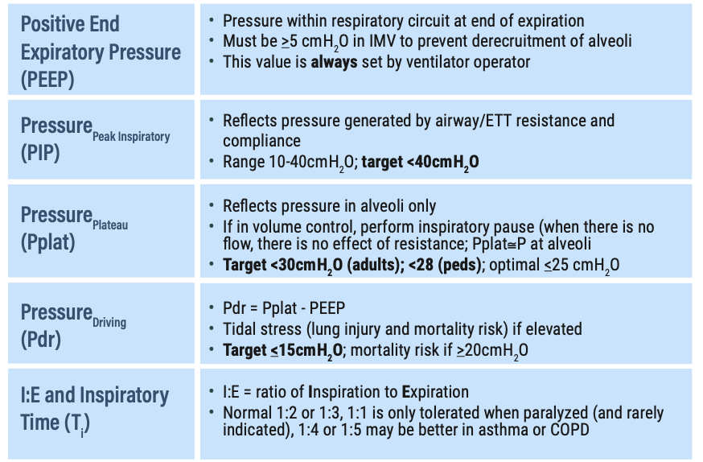
Vent Terminology

Slide 23
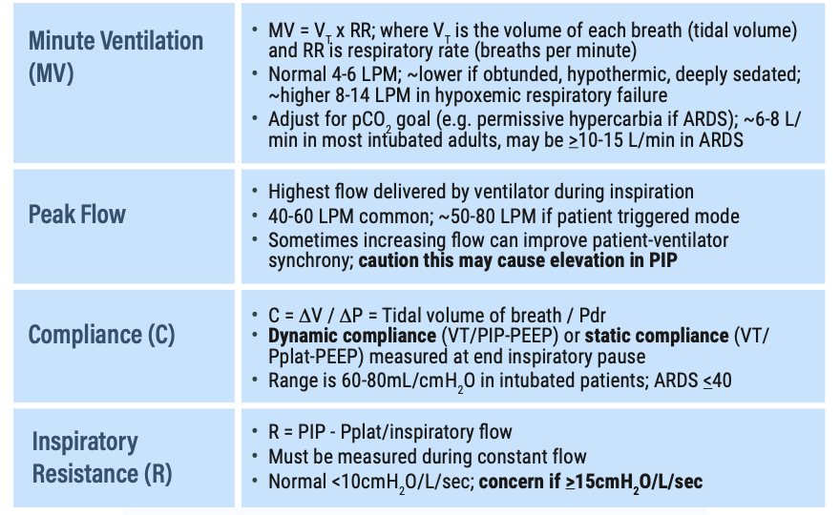
Vent Terminology

Slide 24
Ventilatory Settings
Tidal Volume
PEEP
Mode (type of assist given by ventilator)
Rate (breaths per minute adjusted based on patients own respiratory rate)
FiO₂ (amount of O₂ being delivered)

Slide 25
PEEP (Positive End Expiratory Pressure)
Pressure given in expiratory phase to prevent closure of the alveoli and allow increased time for O₂ exchange.
Used in patients who haven’t responded to treatment and are requiring high amount of FiO₂.
PEEP will lower O₂ requirement by recruiting more alveoli.
Normal PEEP is approximately 5cmH₂O, can be as high as 20cmH₂O.

Slide 26
Modes of Mechanical Ventilation
CMV – Continuous Mandatory Ventilation : PC/VC
ACV - Assist Control Ventilation : PC/VC
SIMV - Synchronised Intermittent Mandatory Ventilation: PC/VC
PSV – Pressure Support Ventilation
APRV- Airway Pressure Release Ventilation
20

Slide 27
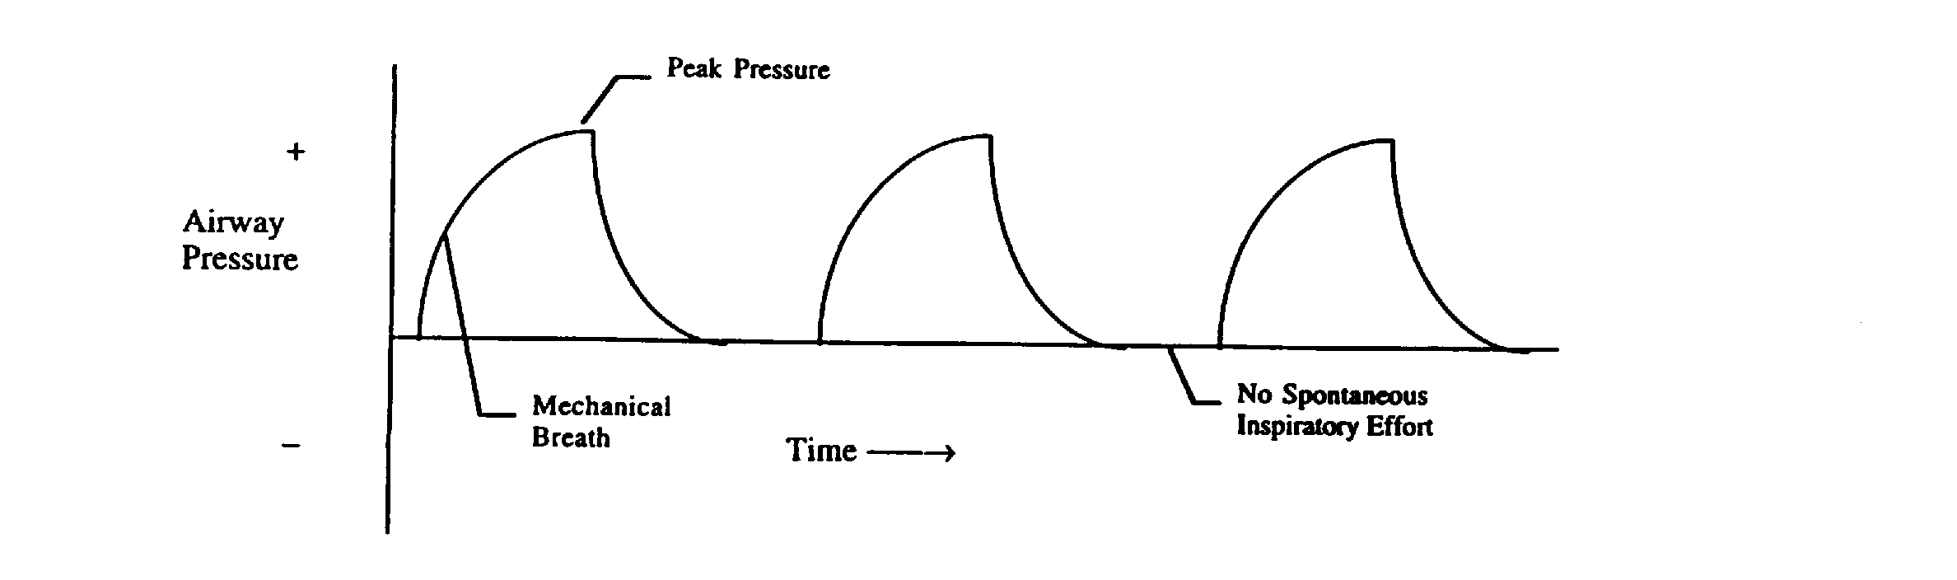
Controlled Mechanical Ventilation
In this mode the ventilator provides a mechanical breath on a pre-set timing.
Patient respiratory efforts are ignored.
This is generally uncomfortable for children and adults who are conscious and is usually only used in an unconscious patient

Slide 28
Assist Control Mechanical Ventilation
Most frequently mode used in Intensive care unit.
Tidal Volume and rate are preset and guaranteed, ensuring minimum minute ventilation.
Patient can trigger additional machine assisted breaths above set rate.
Machine delivers the same tidal volume during every inspiration, whether initiated by ventilator or patient.

Slide 29
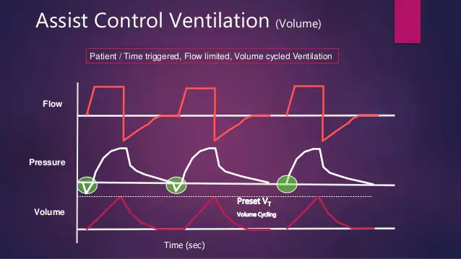
Assist Control Mechanical Ventilation
The work of breathing is reduced to amount of inspiration needed to trigger inspiratory cycle of machine.

Slide 30
Synchronized Intermittent Mandatory Ventilation (SIMV)
Pre-set mechanical breath (pressure or volume limited)
  Respiratory rate of 12 results in a 5 second cycle time.
Within that cycle time the ventilator waits for the patient to initiate a breath using either a pressure or flow sensor.
When the ventilator senses the first patient breathing attempt within the cycle, it delivers the preset ventilator breath.

Slide 31
Synchronized Intermittent Mandatory Ventilation (SIMV)
If the patient fails to initiate a breath, the ventilator delivers a mechanical breath at the end of the breath cycle.
Additional spontaneous breaths after the first one within the breath cycle do not trigger another SIMV breath.
Weaning mode

Slide 32
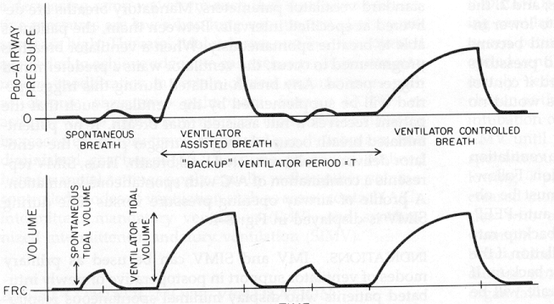
Synchronized Intermittent Mandatory Ventilation (SIMV)

Slide 33
Pressure Support Ventilation
Spontaneous mode
Patient initiates breath and ventilator delivers pre-set inspiratory pressure to help overcome airway resistance
Patient controls the rate, tidal volume and minute ventilation
TV is variable
Can be used in conjunction with SIMV or CPAP
ALWAYS set low TV / MV alarm and apnea backup

Slide 34
Airway Pressure Release Ventilation (APRV)
Differs from conventional Vent
Elevation of airway pressures with brief intermittent release of airway pressure.
Facilitates oxygenation and CO₂ clearance.
Maybe an deployed in ALI/ARDS.

Slide 35
Complications of Mechanical Ventilation
Asynchrony (“bucking”)
Auto PEEP
  Patient does not expire full tidal volume and air becomes trapped.
  Can cause increased alveolar damage.
Baro-Trauma
  Damage to alveoli caused by increased pressure and volume.

Slide 36
Complications of Mechanical Ventilation
Hemodynamic Compromise
Nosocomial infection
Ulcers/gastritis/malnutrition
Muscle deconditioning/ Vent dependence

Slide 37
Thank You

