Slide 1



ICMR Guidelines for covid testing

Slide 2
Advisory on Strategy for COVID-19 Testing in India (Version VI, dated 4th September 2020)
Testing Categories
A. Routine surveillance in containment zones and screening at points of entry
B. Routine surveillance in non-containment areas
C. In Hospital Settings
D. Testing on demand
Choice of Test on Priority
Category A - RAT
Category B & C - RTPCR/TrueNat/CBNAAT
Category D - State Governments to decide simplified modalities
In cases where the RAT test turns to be negative then the sample has to be retested by RTPCR
All RTPCR and RAT test results should be uploaded on ICMR portal at: https://cvstatus.icmr.gov.in.
Reference: https://www.icmr.gov.in/pdf/covid/strategy/Testing_Strategy_v6_04092020.pdf

Slide 3
Guidelines for storage of respiratory specimens collected for
COVID-19 diagnosis by RT PCR platforms in Government laboratories
In the ongoing laboratory testing for COVID-19 diagnosis by molecular diagnostic methods, clinical specimens or a subset of the clinical specimens may need to be retained for various purposes such as
performing additional tests,
for quality control purposes or
for use as control materials to assess newer diagnostic tests.
In addition, for projects aimed at studying genomic epidemiology of the SARS CoV2 virus across regions and over time.
All samples being stored for a long-term must be appropriately labelled indicating laboratory identifiers, date of sample collection and must be stored in properly functioning -80ºC deep freezers.
A proper inventory (preferably electronic) of stored samples should be essentially maintained.

Slide 4
Guidelines for storage of respiratory specimens collected for
COVID-19 diagnosis by RT PCR platforms in Government laboratories
a) Laboratories that are serving as validation centres for COVID-19 diagnostic kits are advised to preserve adequate numbers of positive and negative samples to prepare appropriate panels for validation etc.
b) At a minimum, all samples testing positive for SARS CoV2 must be retained for at least 30 days from the date of testing before being destroyed. Depending on the freezer space availability in a particular laboratory, one or more aliquots of the positive specimen may be retained for the period.
c) A government laboratory may decide on the number of positive / negative samples to retain in the long term based on the availability of freezer space as well as perceived research agenda of the laboratory for COVID-19 in the future.

Slide 5
Guidelines for storage of respiratory specimens collected for
COVID-19 diagnosis by RT PCR platforms in Government laboratories
d) If the number of samples tested positive at a laboratory is considerably large and the laboratory is unable to retain all positive samples beyond 30 days, a minimum of 10% of all positives detected at the laboratory in a month or 40-50 positives preferably with equal numbers of high, moderate and low viral load should be stored for a period of 1 year at the least. A single aliquot of a positive sample may be retained taking into account freezer space availability at the laboratory.
e) Considering that the number of samples tested negative at each laboratory will vary depending on the sample load and testing capacity of the laboratory, a minimum of 50 samples or 1-2% of all negative tested samples over a month, whichever is smaller should be retained at the testing laboratory for a period of 1 year. A single aliquot of a negative sample may be retained taking into account freezer space availability at the laboratory

Slide 6
ILC – ICMR Designated QC Lab
All labs will have to send 5 random positive and 5 random negative samples per month to QC labs.
ICMR has mapped COVID-19 testing labs to different QC labs (Annexure I).
All testing labs should liaise with the recommended QC labs and will ensure regular participation in QC activity.
All testing labs will ensure storage of samples at -80̊C and will ensure regular monthly transfer to QC labs.
Don't forget to include your lab name and sample ID.
While shipping, place samples in screw capped vials and proper Biosafety and Biosecurity precautions should be followed as per IATA guidelines.

Slide 7
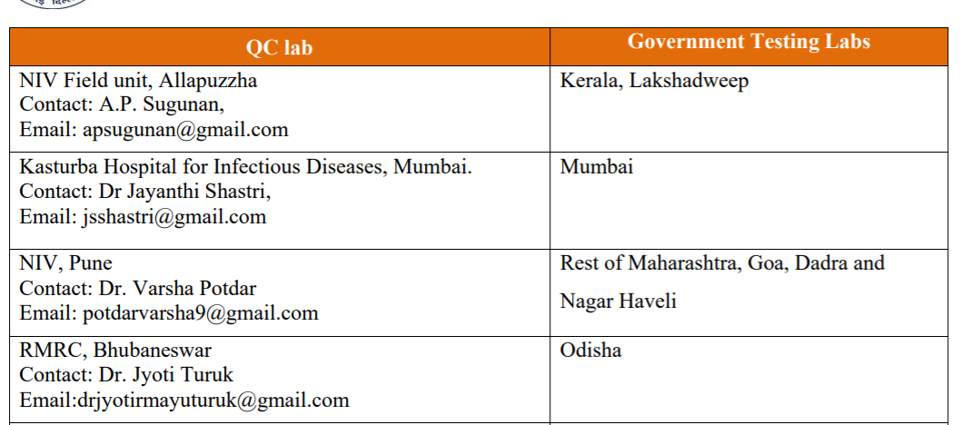
ILC – ICMR Designated QC LAb
In case of any discordance, additional 5 positive and 3 negative samples will need to be sent for QC check.
If QC results are concordant, all the QC samples may be destroyed and labs will keep record of destruction.
Appropriate procedures to disinfect all samples prior to disposal must be followed.
ICMR Designated QC lab

Slide 8
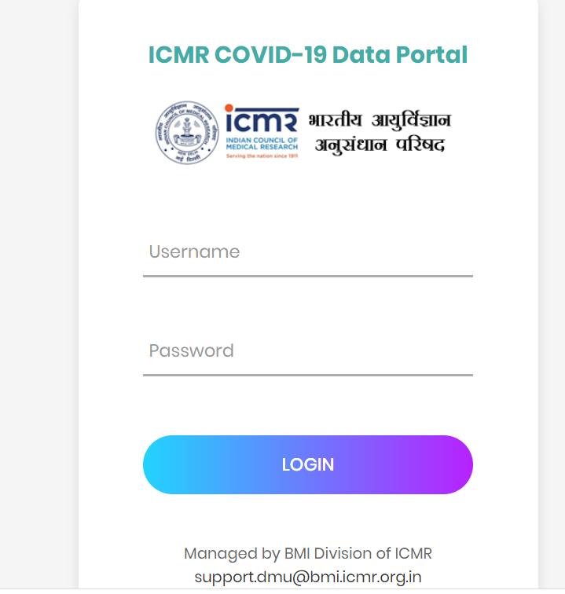
ILC – ICMR Designated QC Lab
All the QC results has to be entered in the QC portal and should not be shared with the QC lab

