Slide 1
Role of RISE Program in Bio Medical Waste Management

Slide 2
Learning objectives for the series
By the end of this series, participants should be able to:
Define disease cycle and standard prevention protocols
Hand hygiene : importance and all steps
PPE : importance, donning doffing
Sharps and Needles: proper handling, PEP in sharp injury
Disinfection and sterilization
Environment cleaning
Spill management : Mercury, blood
Laundry and linen management
Dead body management

Slide 3
Learning objectives for today
Sources of infection
Disease cycle
Modes of disease transmission
Importance of infection prevention.
Basic principles of standard precautions and transmission-based precautions.

Slide 4
Infection
The entry and development/multiplication of an infectious agent in the body of man or animals.
It also implies that the body responds in some way to defend itself against the invader, wither in the form of an immune response or disease.
An infection does not always cause an illness

Slide 5
Infectious disease
A clinically manifest disease of man or animal resulting from an infection
Contagious disease
A disease that is transmitted through a contact
Communicable disease
All illness due to specific infectious agent or its toxic products capable of being directly or indirectly transmitted from man to man, animal to animal or environment (through air, dust, soil, water, food etc.) to man or animal

Slide 6
The three links
Source/reservoir of infection
Modes of transmission
Susceptible host

Slide 7
Sources of infection
Places where infectious agents (germs) live (e.g., sinks, surfaces, human skin)
Malaria Infective female Anopheles mosquito
Tuberculosis Infective human being
Cholera Infective human being and water
HIV Infective human being

Slide 8
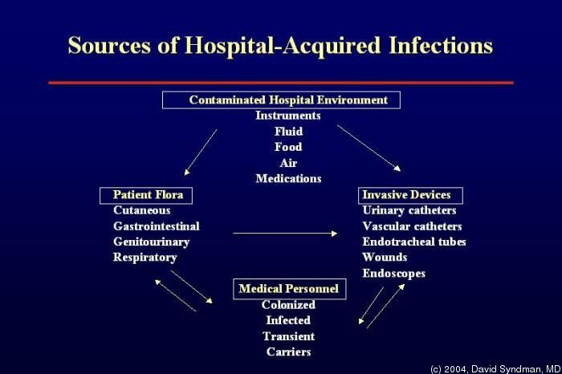
Sources of hospital acquired infections

Slide 9
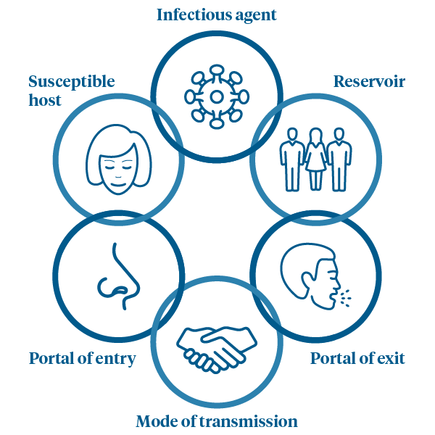
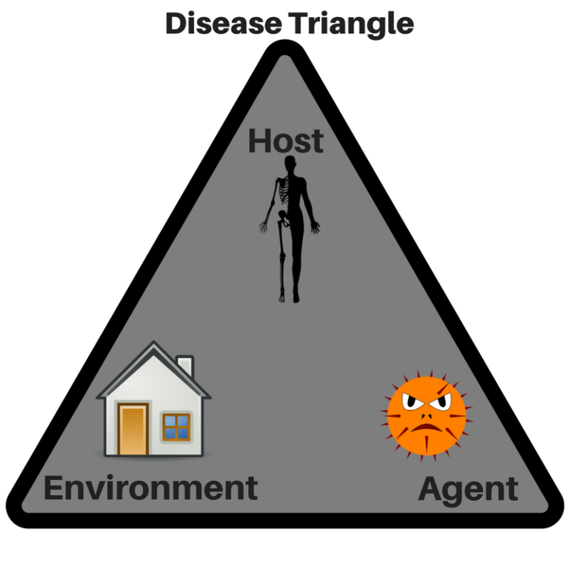
Disease Cycle and Transmission

Slide 10
Infection prevention and control (IPC)
According to the WHO, Infection prevention and control (IPC) is a scientific approach and practical solution designed to prevent harm caused by infection to patients and health workers.
This approach is grounded in infectious diseases, epidemiology, social science and health system strengthening.
IPC occupies a unique position in the field of patient safety and quality universal health coverage since it is relevant to health workers and patients at every single health-care encounter

Slide 11
Basic principles of standard precautions and transmission-based precautions
All objects in contact with the client: Potentially contaminated
Every person: Potentially infectious
If an object is disposable: Discard as waste.
If reusable: Prevent infection by decontamination cleaning, disinfecting or sterilizing

Slide 12
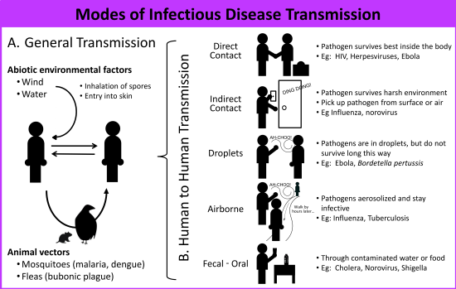

Slide 13
Why is infection prevention important?
To prevent the occurrence of infections and to minimize the risk of transmitting any infections including COVID 19 to clients, health care staff and community.

Slide 14
Standard Precautions
Hand washing
Use of protective attire
Processing of used items
Proper handling and disposal of sharps
Maintaining a clean environment
Biomedical waste disposal

Slide 15
Review of the session
What are the sources of infection?
How can you explain the disease cycle?
What are the modes of disease transmission?
Why is infection prevention important?
What are the basic principles of standard precautions and transmission-based precautions.

Slide 16
Thank you

