Slide 1
WELCOME TO IPC/WASH TRAINING SESSIONS Session 2

Slide 2
Recap Day 1
How many standard precautions are there?

Slide 3
Session Objectives
In this session 2 standard precautions will be covered
1. Hand hygiene
To understand the importance of hand hygiene
To learn when and how to perform hand hygiene
To understand what is PPE
To learn correct procedure of wearing and removing gloves

Slide 4
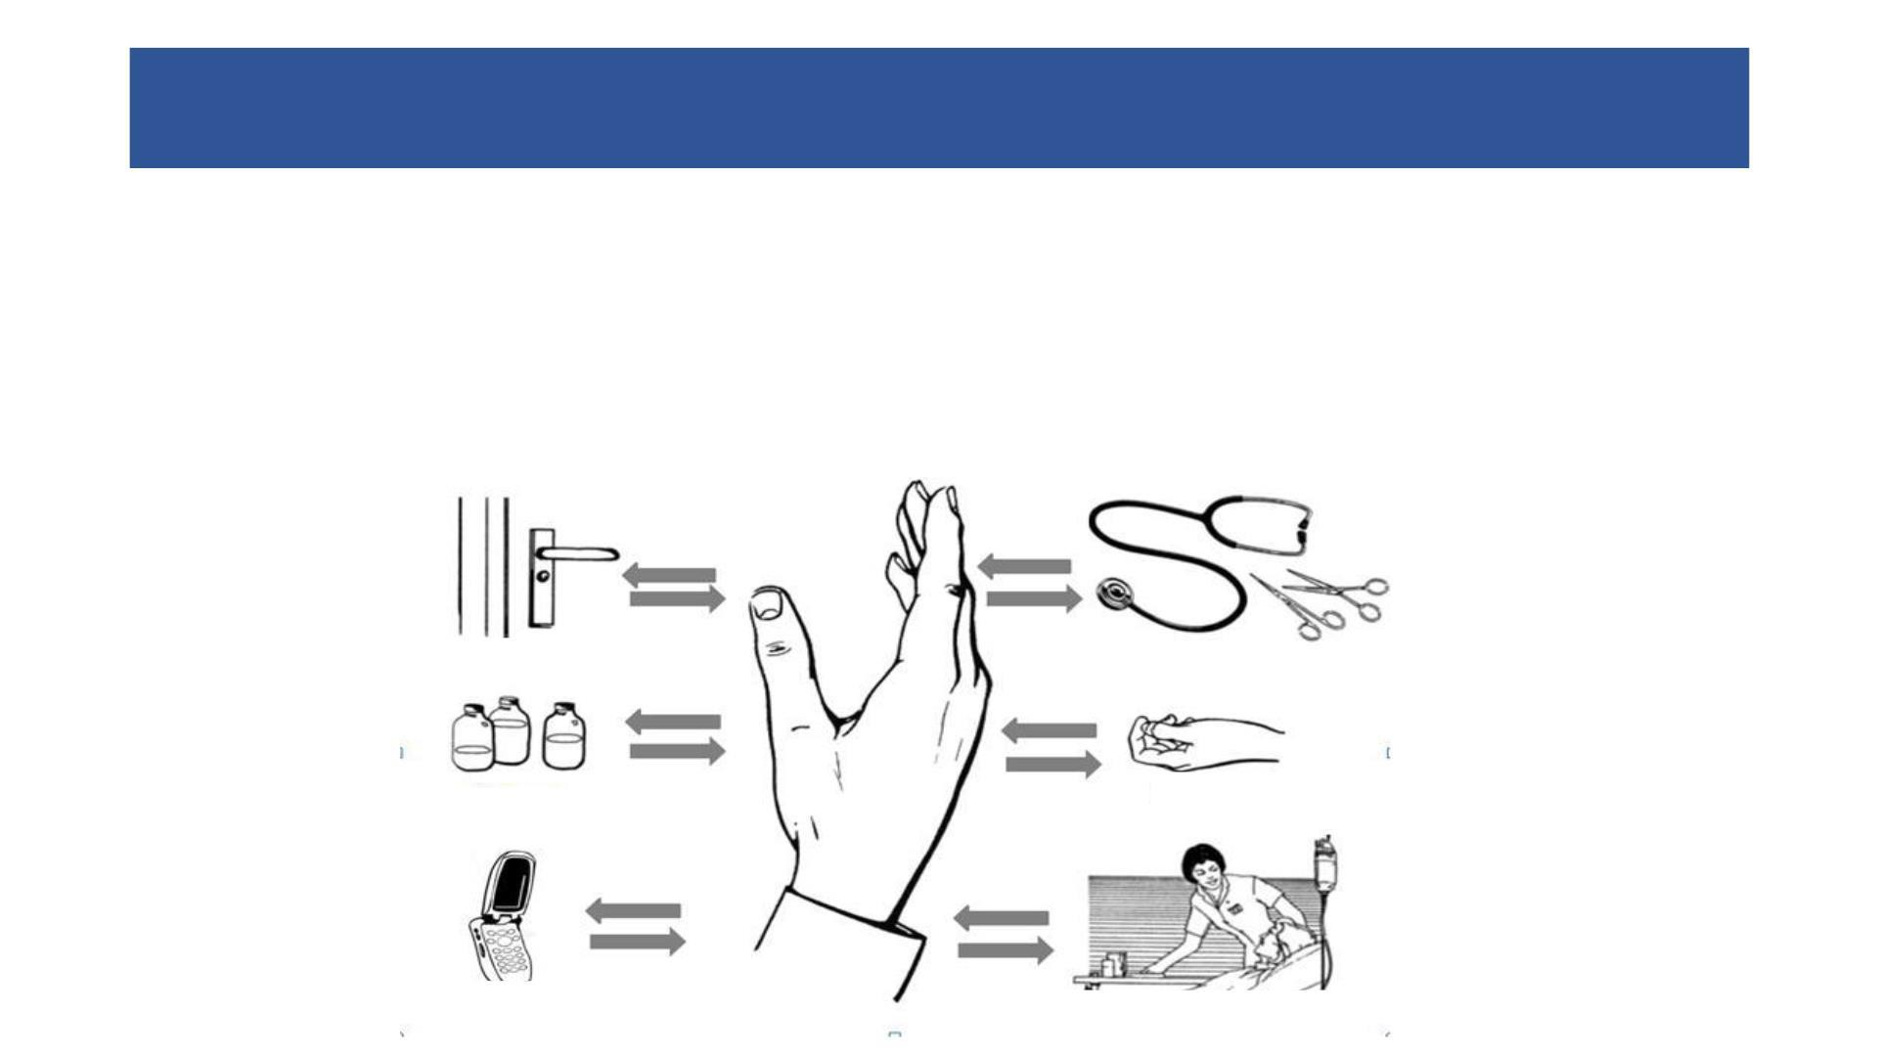
Why Hand Hygiene?
Our hands are our main tool for work as health care workers- and they are the key link in the chain of transmission.
Best way to prevent the spread of germs in the health care setting and community.
Door handles
Instruments
Medication
Cellphones
Caregivers

Slide 5
Poll
Question: Number of moments when one should perform hand hygiene?
Answer:
4
5
6
7

Slide 6
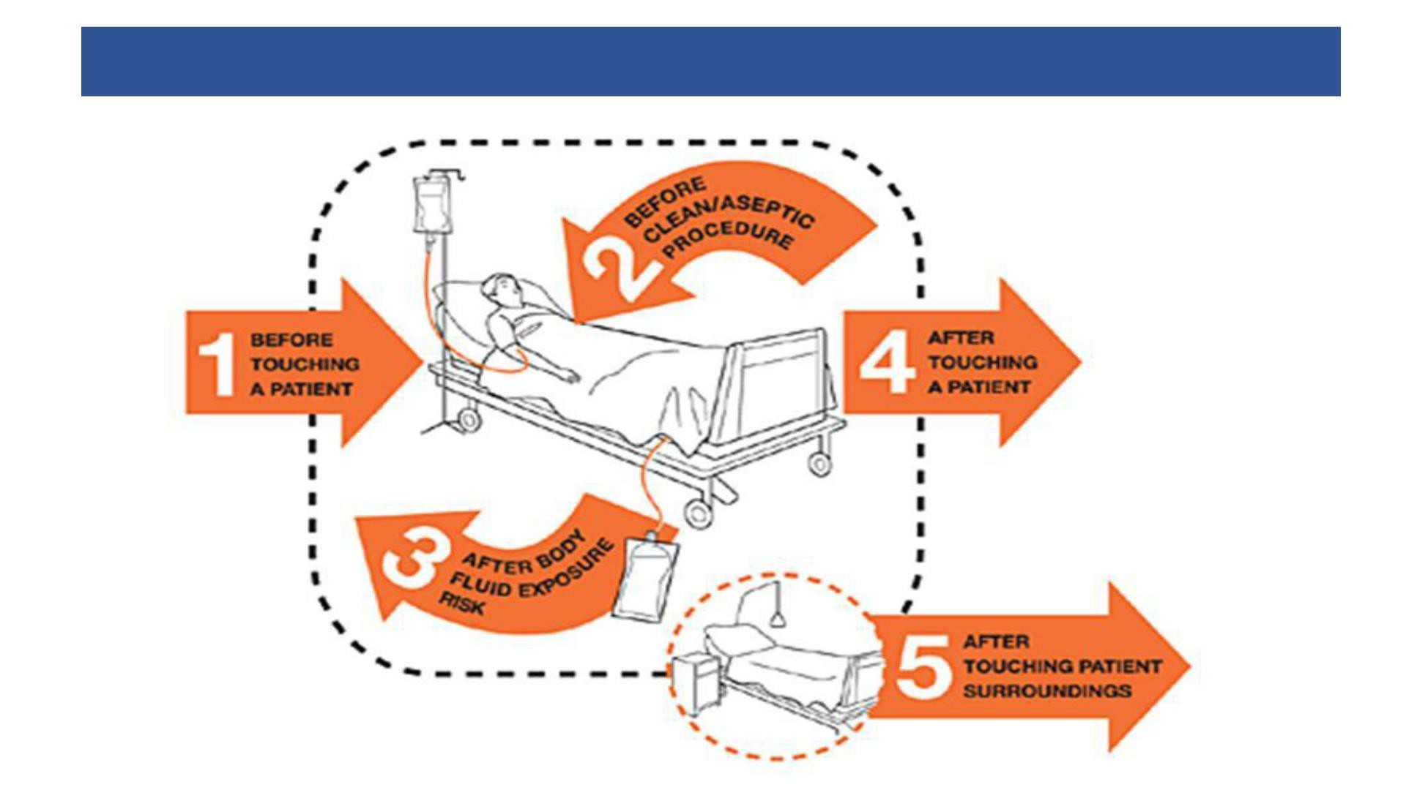
Hand Hygiene: WHO Five moments
https://www.who.int/infection-prevention/tools/hand-hygiene/en/

Slide 7
Hand Hygiene: WHO Five moments

Slide 8
Question: What are the methods of hand hygiene?

Slide 9
Preferred Method of Hand Hygiene
Soap and Water (Hand wash)
Alcohol-based Hand Rub
When visibly dirty
When visibly soiled with blood or other body fluids
After using toilet
Suspected or proven exposure to potential spore forming pathogens including outbreaks of C. difficile (preferred) and contact with patients of wet gangrene.
If hands are not visibly soiled
Before and after touching the patient
If moving from a contaminated body site to another body site during care of the same patient
After contact with inanimate surfaces and objects (including medical equipment) in the immediate vicinity of the patient.
After removing sterile or non-sterile gloves
Before handling medication or preparing food
Before handling an invasive device for patient care, regardless of whether or not gloves are used
After contact with body fluids or excretions, mucous membranes, non-intact skin, or wound dressings

Slide 10
Prerequisite for hand hygiene in clinical setting
Keep nails short and pay attention to them when washing your hands – most microbes on hands come from beneath the fingernails.
Do not wear artificial nails or nail polish
Remove all jewelry (rings, watches, bracelets).
Wash hands and arms with a non-medicated soap before entering the operating theatre area
Clean subungual areas with a nail file.
Functional Hand washing station: with preferably liquid soap and water available.

Slide 11
Hand Wash Using Soap and Water
Note:
✓ Each step to be done five times
✓ Nails should be cut and hands should be without jewelry for best results
Source - WHO Guidelines on Hand Hygiene in Healthcare

Slide 12
Note:
✓ Each step to be done five times
✓ Nails should be cut and hands should be without jewellery for best results
Source - WHO Guidelines on Hand Hygiene in Healthcare

Slide 13
Recap of the sessions 2 and 3
1: Steps of hand hygiene
2: When to perform hand wash
3: When ABHR can be done?
4: Sequence of donning PPE?
6: Sequence of doffing PPE?

Slide 14
Home assignment
Practices Hand washing steps using the video and job aids
Practice steps of wearing and removing gloves using video and job aids
Revise sequence of donning & doffing PPE

