Slide 1
WELCOME TO IPC/WASH TRAINING SESSIONS
Session 3A

Slide 2
Session Objectives
In this session 2 standard precautions will be covered
1. Use of protective attire (PPE)
To understand what is PPE
To learn correct procedure of wearing and removing gloves
To learn the correct sequence and process of donning and doffing PPE

Slide 3
Personal Protective Equipment (PPE)
PPE refers to a variety of barriers and respirators used alone or in combination to protect
Mucous membranes
Airways
Skin and
clothing from contact with infectious agents
The selection of PPE is based on the
Nature of the patient interaction
Likely mode(s) of transmission of pathogen
Hand hygiene is always the final step after removing and disposing of PPE.

Slide 4
Question: What constitutes PPE?
Answer in chat boxes

Slide 5
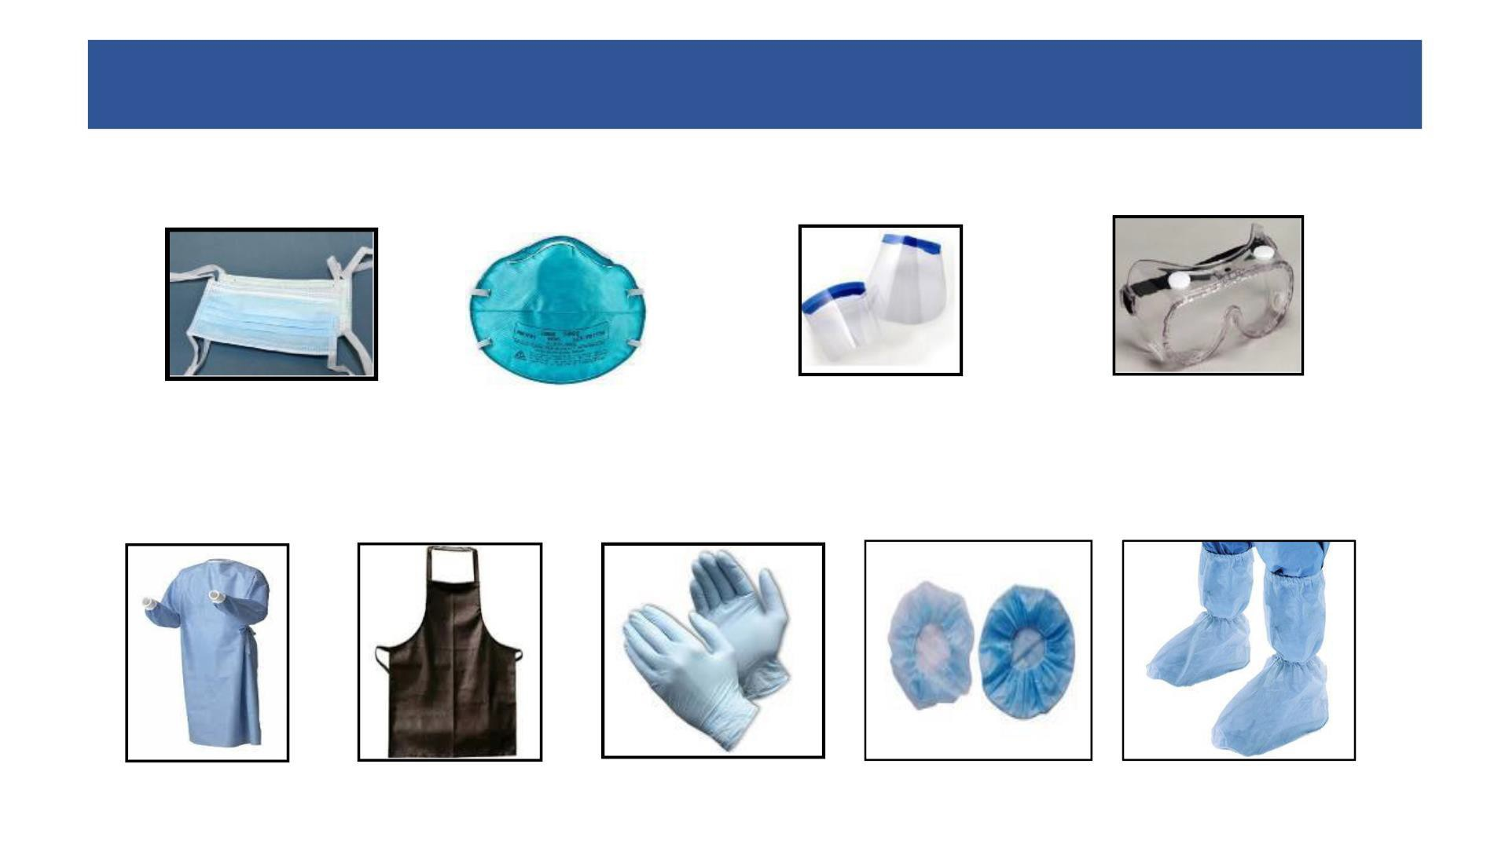
PPE for use in health care for Infection prevention
Face Mask
N95 Mask
Face shield
Goggle
PPE for cleaning staff
Cap
Mask
Gown
Utility gloves
Gum boots
Nose + mouth
Nose + mouth
Eyes + Face
Eyes
Gown
Apron
Gloves
Head cover
Shoe cover
Body
Body
Hands
Head + hair
Feet
Source: WHO2015
Liberia Safe & Quality Health Services Package

Slide 6
Question: Why service providers should wear gloves?
Answer in chat boxes

Slide 7
GLOVE USE
Gloves are the most common type of PPE used in healthcare settings. Use of gloves helps to:
Reduce the risk of contaminating HCWs hands with blood and other body fluids
Reduce the risk of germ dissemination to the environment and of transmission from the HCWs to the patient and vice versa, as well as from one patient to another.
How they should be used
Should be changed between patients
Change gloves while moving from a contaminated body-site to a clean body site
After removal of Gloves perform hand hygiene
Should not be reused/ washed: At present no standardized, validated and affordable procedure for safe glove reprocessing exists.
Protect patients:
Using the correct technique for donning gloves.
Protect health workers: Using the correct technique for removing gloves

Slide 8
The Glove Pyramid
To aid decision making
on when to wear (and not wear) gloves
Sterile gloves
Any surgical procedure
Vaginal delivery
Invasive radiological procedures
Vascular access & procedures

Slide 9
Rational use of PPE at the OPD/IPD/Emergency/Support Services/Ambulance
Setting | Activity | Risk | Recommended PPE |  |  |  |  | Remarks
 |  |  | Medical Mask | Gloves | N 95 mask | Goggles | Face Shield
Help Desk / Regn Counter | Provide Information to patients | Mild |  |  | ❒ | ❒ | ❒ | Physical distancing
Doctor's Chamber | Clinical Management | Mild |  |  | ❒ | ❒ | ❒ | Aerosol generating procedures should not allowed
Flu OPD/fever clinic | Clinical Management | Moderate | ❒ |  |  |  |  | Aerosol generating procedures anticipated Face Shield only when splash of blood is expected
Pre Anesthesia Check Up Clinic | Pre Anesthesia Check Up | Moderate | ❒ |  |  |  | ❒ | Gloves recommended when close examination of oral cavity/dentures is to be done
Pharmacy Counter | Distributing of drugs | Mild |  |  | ❒ | ❒ | ❒ | Frequent use of hand sanitizer is advised over gloves.
Sanitary Staff | Cleaning frequently touched surfaces/ floors | Mild |  |  | ❒ | ❒ | ❒

Slide 10
Rational use of PPE at the OPD/IPD/Emergency/Support Services/Ambulance
Setting | Activity | Risk | Recommended PPE |  |  |  |  | Remarks
 |  |  | Medical Mask | Gloves | N 95 mask | Goggles | Face Shield
Wards / Individual Rooms | Clinical Management | Mild |  |  | ❒ | ❒ | ❒ | Patients stable. No aerosol generating activity
ICU / Critical Care | Critical Care Management | Moderate | ❒ |  |  |  |  | Aerosol generating activities performed Face Shield only when splash of blood is expected
Ward/ICU /critical care | Non covid Dead body packing | Mild |  |  | ❒ | ❒ | ❒
Labour Room | Intrapartum care | Moderate | ❒ |  |  |  | ❒ | Patient to be masked in the Labor room
Operation Theatre | Performing surgery, administering general anaesthesia | Moderate |  |  |  |  |  | Goggles only for personnel involved in aerosol generating Procedures *If the person being operated upon is a resident of containment zone
Sanitation | Cleaning frequently touched surfaces/ floors / changing linen | Mild |  |  | ❒ | ❒ | ❒

Slide 11
Rational use of PPE at the OPD/IPD/Emergency/Support Services/Ambulance
Setting | Activity | Risk | Recommended PPE |  |  |  |  | Remarks
 |  |  | Medical Mask | Gloves | N 95 mask | Goggles | Face Shield
Emergency | Attending emergency cases | Mild |  |  | ❒ | ❒ | ❒ | No aerosol generating procedures are allowed
 | Attending to severely ill patients while performing aerosol generating Procedure | High | Full complement of PPE (N-95 mask, gown(PPE Suit), goggle, Nitrile Examination gloves, shoe cover)
Routine Lab | Sample collection and transportation and testing of routine (nonrespiratory) samples | Mild |  |  | ❒ | ❒ | ❒
 | Respiratory samples | Moderate | ❒ |  |  | ❒ | ❒
Radiodiagnosis, Blood bank, etc. | Imaging services, blood bank services etc. | Mild |  |  | ❒ | ❒ | ❒
CSSD / Laundry | Handling Linen | Mild |  |  | ❒ | ❒ | ❒

Slide 12
Rational use of PPE at the OPD/IPD/Emergency/Support Services/Ambulance
Setting | Activity | Risk | Recommended PPE |  |  |  |  | Remarks
 |  |  | Medical Mask | Gloves | N 95 mask | Goggles | Face Shield
Other supportive services incl. Kitchen | Administrative Financial Engineering** and dietary** services, etc. | Mild | ❒ | ❒ | ❒ | ❒ | Face shield | ** Engineering and dietary service personnel visiting treatment areas will wear personal protective gears appropriate to that area
Ambulance Transfer to designated hospital | Transporting patients not on any assisted ventilation | Mild |  |  | ❒ | ❒ | ❒ | No aerosol generating procedures are allowed
 | Driving the ambulance | Mild |  |  | ❒ | ❒ | ❒ | Driver helps in shifting patients to the emergency
 | Management of SARI patient | High | Full complement of PPE (N-95 mask, gown/PPE suit goggle, Nitrile Examination gloves, shoe cover) |  |  |  |  | While performing aerosol generating Procedure

Slide 13
Sequence of donning and doffing PPE
Sequence of donning PPE
1. Hand hygiene
2. 1st pair of gloves
3. Gown/coverall
4. Shoe Cover
5. N95 mask and hood
6. Goggles/face shield
7. 2nd pair of gloves
Sequence of doffing PPE
1. Check for any tear / leak
2. Disinfect gloves
3. Remove shoe cover
4. Disinfect and remove outer pair of gloves
5. Disinfect inner glove
6. Remove face shield/goggle
7. Disinfect inner glove
8. Remove hood and coverall
9. Disinfect and remove inner gloves
Sequence of doffing PPE
10. Perform hand hygiene & wear a new pair of gloves
11. Remove N95 mask
12. Disinfect gloves
13. Disinfect shoes
14. Disinfect and remove gloves
15. Perform hand hygiene

Slide 14
Recap of the session
1: Steps of hand hygiene
2: When to perform hand wash
3: When ABHR can be done?
4: Sequence of donning PPE?
6: Sequence of doffing PPE?

Slide 15
Home assignment
Practices Hand washing steps using the video and job aids
Practice steps of wearing and removing gloves using video and job aids
Revise sequence of donning & doffing PPE

