Slide 1

Proper Handling of Sharps
And Injection Safety

Slide 2
Learning Objectives
Learn About Proper Handling and Disposal of Sharps and Needles
Needle Stick Injury – What To Do
Need of Post Exposure Prophylaxis (PEP)

Slide 3
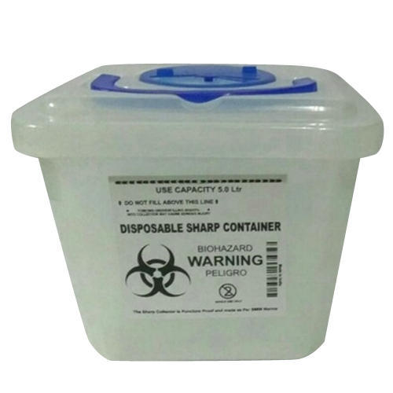
Proper Handling and Disposal of Metal Sharps
Dispose off needles, scalpels, blades, syringes with fixed needles etc. in a puncture-proof WHITE (translucent) container
Dispose off sharps at the point of use
Always wear UTILITY GLOVES while handling sharps

Slide 4
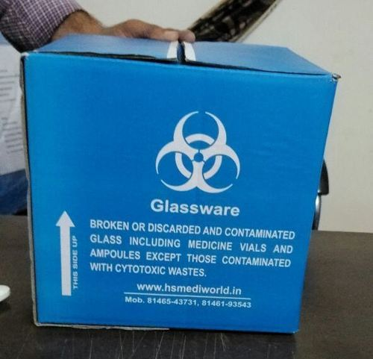
Proper Handling and Disposal of Glassware
Dispose off the glassware waste (broken glasses, medicine vials, ampules) in cardboard boxes with blue colored marking
Before handing it over to the CBMWTF or disposing in the sharp pits, pre-treat with 1% chlorine solution for at least 20 minutes.
Always wear UTILITY GLOVES while handling sharps

Slide 5
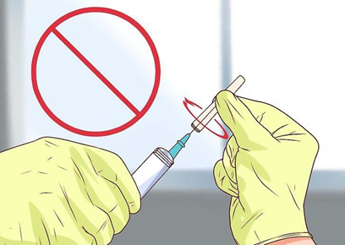
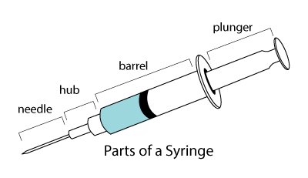
Proper Handling and Disposal of Needles and Syringes
Use disposable needle and syringe ONLY ONCE
Do not disassemble the needle and syringe after use
Do not recap the needle
Do not bend the needle
Do not burn the needle
Always cut the syringe from its hub

Slide 6
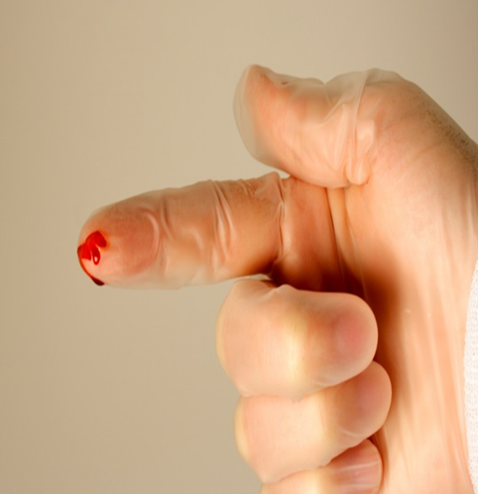
Needle Stick Injury – What to do
Wash the site with soap and water. Do not apply any chemical cleansers.
Do not squeeze the wound.
Report all injuries to ensure appropriate follow up.
The risk from needle stick injuries can be minimized by:
(1) Planning for safe handling and safe disposal before using needles
(2) Disposing off used needles promptly in sharps disposal containers
(3) Getting Hepatitis B Vaccination.

Slide 7
Post Exposure Prophylaxis (PEP)
Post exposure prophylaxis (PEP) refers to the comprehensive management given to minimize the risk following exposure to blood borne pathogens (HIV, HBV and HCV).
The risk of infection depends on (1) The nature of exposure, and (2) The status of the source patient
Recommended regimen for PEP is Tenofovir 300 mg + Lamivudine 300 mg + Efavirenz 600 mg
The first dose of PEP should be administered as soon as possible, ideally within 2 hours of exposure.

Slide 8

Thank You !

