Slide 1

Session 4A
Disinfection & sterilization
Maternal Health Division
Ministry of Health & Family Welfare
Government of India

Slide 2
Learning Objectives
    Preparation of chlorine solution
    Uses of different chlorine solution strengths
    Disinfection/sterilization of instruments, autoclave processing
    Environment & general cleaning and disinfection
    Disinfecting PPEs used during cleaning (Utility gloves/reusable plastic aprons)

Slide 3
Preparation of Chlorine solutions
Maternal Health Division
Ministry of Health & Family Welfare
Government of India

Slide 4
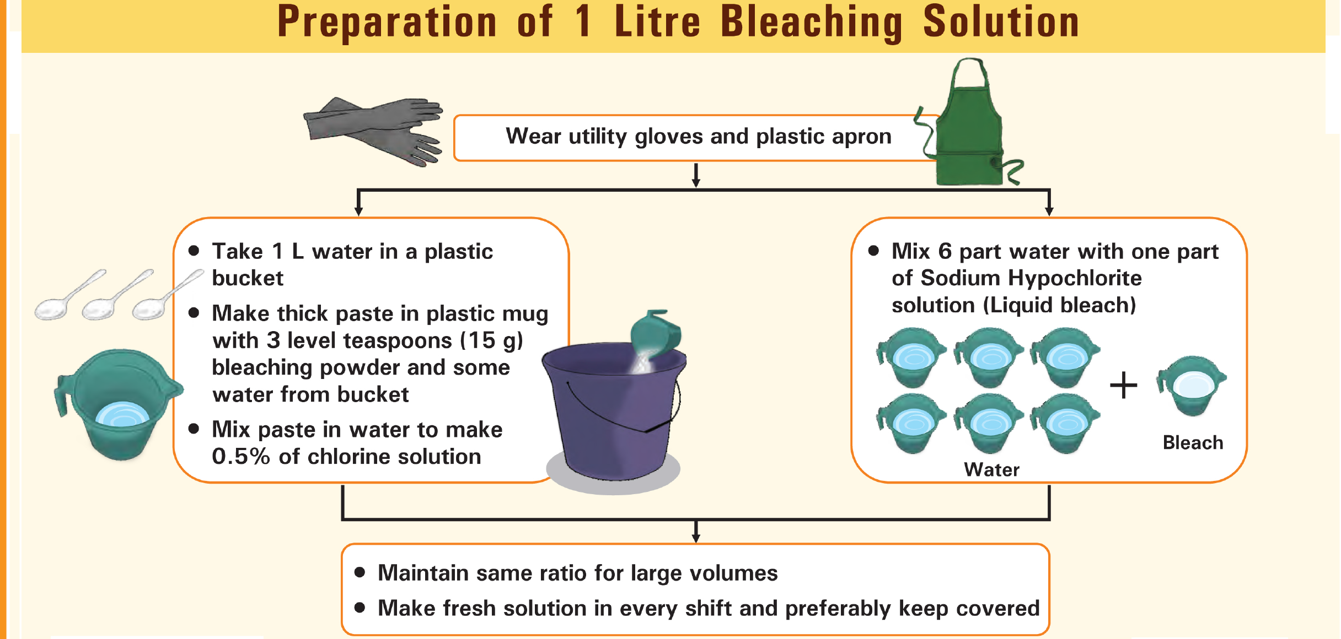

Slide 5
Preparation of Chlorine solution using Bleaching Powder
Strength of SBP (stable bleaching powder) | Volume of water | Desired concentration | Bleaching powder in grams per litre
20% | 1 litre | 0.50% | 25
 |  | 1% | 50
 |  | 2% | 100
 |  | 5% | 250
 |  | 10% | 500
25% | 1 Litre | 0.50% | 20
 |  | 1% | 40
 |  | 2% | 80
 |  | 5% | 200
 |  | 10% | 400
30% | 1 Litre | 0.5% | 17
 |  | 1% | 33
 |  | 2% | 67
 |  | 5% | 167
 |  | 10% | 333
33% | 1 Litre | 0.5% | 15

Slide 6
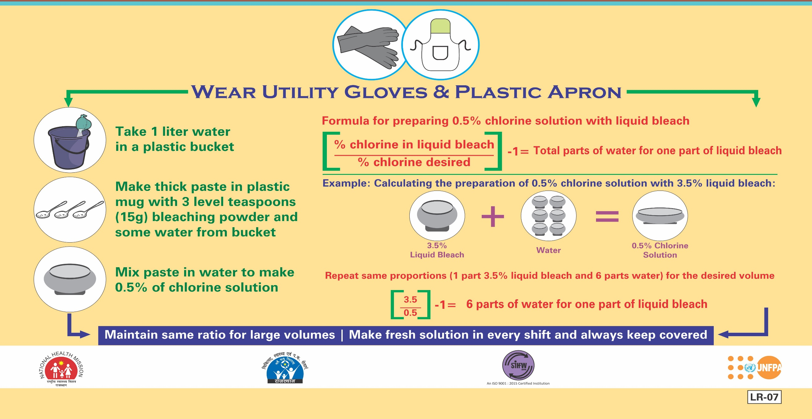
Preparation of Chlorine solution using Hypochlorite Solution

Slide 7
Need for proper disinfection/sterlization
Transmission of the infection through used equipment and instruments can happen between patients through use of unsterile or partially sterilized instruments and equipment and also to the staff through injury from the used instruments.
According to the WHO, hundreds of millions of patients are affected by HAIs around the world every year, leading to significant mortality and huge financial losses. For every 100 hospitalised patients, seven in high-income and 10 in middle-income countries develop HAIs. And the ICU-acquired infection rate is at least 2-3-times higher in middle-income countries than that in high-income countries, where it’s about 30%.
Dr Soumya Swaminathan, the chief of the Indian Council of Medical Research (ICMR) in 2017, and now chief scientist at the WHO, admitted in that India does not have accurate estimates of the burden of HAIs. ( British Medical Journal)
Numerous facilitiy based studies have highlighted the high economic costs associated with Hospital acquired Infections in India (Ghosh P,Valia R)

Slide 8
Disinfection/sterilization of instruments, autoclave processing
Maternal Health Division
Ministry of Health & Family Welfare
Government of India

Slide 9
Classification of Medical instruments and required level of reprocessing
Level | Risk of Infection | Description | Examples of items | Reprocessing Methods
Critical | High | Item comes in contact with or enters sterile tissue,sterile body cavity, or vascular system | Surgical and Dental instruments, some endoscopes, inner surfaces of hemodialyzers, Urinary catheters, Biopsy forceps,Implants and needles | Cleaning followed by Sterlization.
Semi Critical | Moderate | Item comes in contact with mucous membrane or non intact skin | Respiratory therapy equipment Anesthesia equipment Tonometer | Cleaning followed by High level disinfection (as a minimum) Sterilization is preferred
Non Critical | Low | Item comes in contact with skin | ECG Machines, Oxymeters, Bed Pans, Urinals, Commodes | Cleaning followed by low level disinfection

Slide 10
Six recommended steps of Instrument reprocessing:
1. Transportation of instruments/equipment
2. Cleaning of instruments and equipment
3. Packaging
4. Disinfection of the instruments/equipment
5. Sterilization
6. Storage and issue

Slide 11
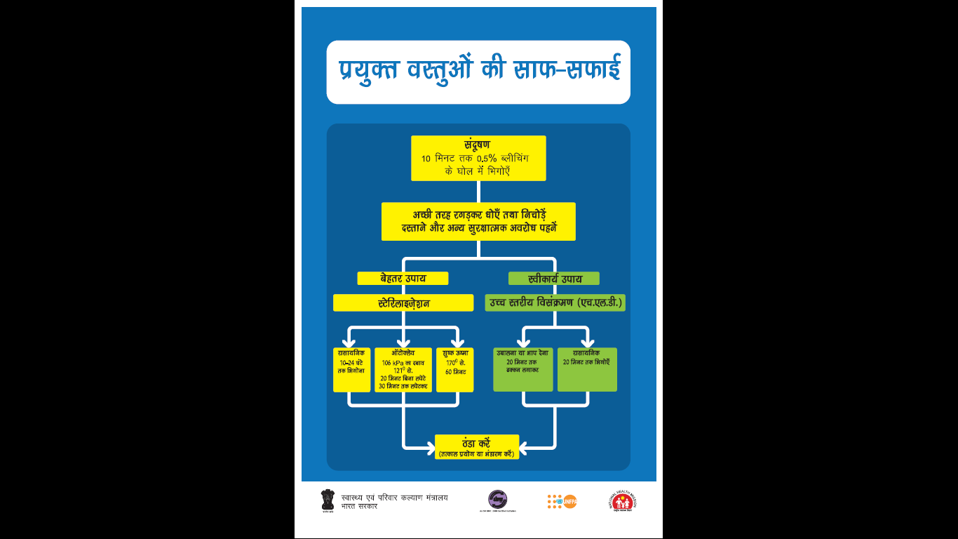
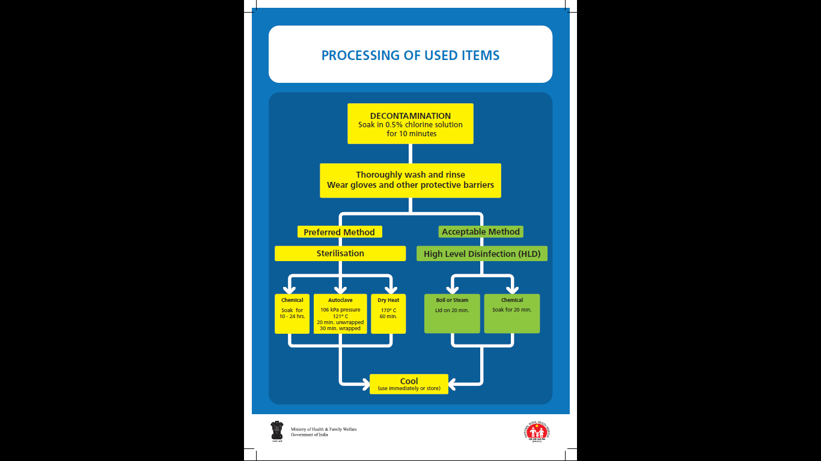

Slide 12
Processing of used items
A. Decontamination:
Preparation of Bleaching solution (0.5%)
Wear utility gloves and plastic apron.
Take 1 litre of water in plastic bucket.
Make thick paste with 3 levelled tea spoons of bleaching powder and water in a plastic mug.
Mix paste in the bucket of water to make 0.5 % chlorine solution.

Slide 13
Processing of used items
B. Cleaning:
Involves - scrubbing with a brush, detergent and water.
Detergent is important for effective cleaning because water alone does not remove proteins, oils and grease.

Slide 14
Processing of used items
C. Sterilization:
Sterilization ensures that items are free of all microorganisms (bacteria, viruses, fungi and parasite) including endospores.
Three methods of sterilisation:
Steam sterilisation / Autoclaving / Pressure cooker autoclaving
Dry heat sterilisation
Chemical / cold sterilisation

Slide 15
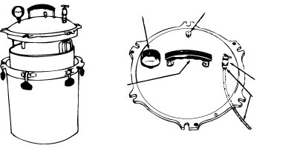
Processing of used items
C. Sterilization:
Pressure cooker type autoclave
Geared steam gauge
Excess pressure relief valve
Top Handle
Control Valve
Air exhaust tube

Slide 16
Processing of used items
C. Sterilization:
High level Disinfection
HLD eliminates bacteria, viruses, fungi and parasites, but does not kill all endospores which cause diseases such as tetanus and gas gangrene.
HLD only acceptable alternative to sterilisation.
There are 3 methods of HLD:
  Boiling
  Chemical HLD
  Steaming

Slide 17
Processing of used items
D. Storage:
To prevent contamination after processing
Do not store instruments or other items such as scalpel blades and suture needles in solution, always store them dry

Slide 18
Monitoring of Sterilization process
Quality control parameters for the sterilisation process which also serve as a checklist for the sterilisation department includes:
Load number
Load content
Temperature and time exposure record chart
Chemical indicator testing (with each load)
Biological Indicator testing (at least weekly)
Regular monitoring of sterilization process using Biological, Chemical and Mechanical indicators is should be carried out.( Detailed discussion in last session)

Slide 19
Video

Slide 20

Thank You !

