Slide 1

Session 4B
Environmental Cleaning
Maternal Health Division
Ministry of Health & Family Welfare
Government of India

Slide 2
Learning Objectives
    Preparation of chlorine solution
    Uses of different chlorine solution strengths
    Environment & general cleaning and disinfection
    Disinfecting PPEs used during cleaning (Utility gloves/reusable plastic aprons)

Slide 3
Preparation of Chlorine solutions
Maternal Health Division
Ministry of Health & Family Welfare
Government of India

Slide 4
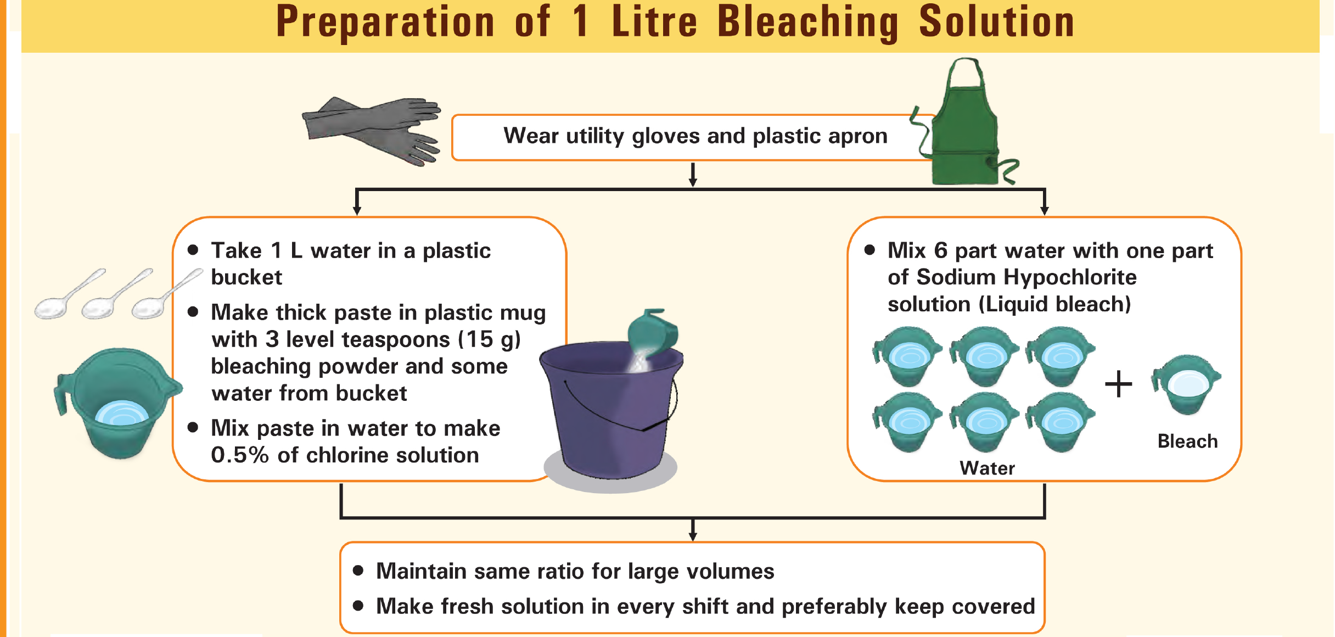

Slide 5
Preparation of Chlorine solution using Bleaching Powder
Strength of SBP (stable bleaching powder) | Volume of water | Desired concentration | Bleaching powder in grams per litre
20% | 1 litre | 0.50% | 25
 |  | 1% | 50
 |  | 2% | 100
 |  | 5% | 250
 |  | 10% | 500
25% | 1 Litre | 0.50% | 20
 |  | 1% | 40
 |  | 2% | 80
 |  | 5% | 200
 |  | 10% | 400
30% | 1 Litre | 0.5% | 17
 |  | 1% | 33
 |  | 2% | 67
 |  | 5% | 167
 |  | 10% | 333
33% | 1 Litre | 0.5% | 15

Slide 6
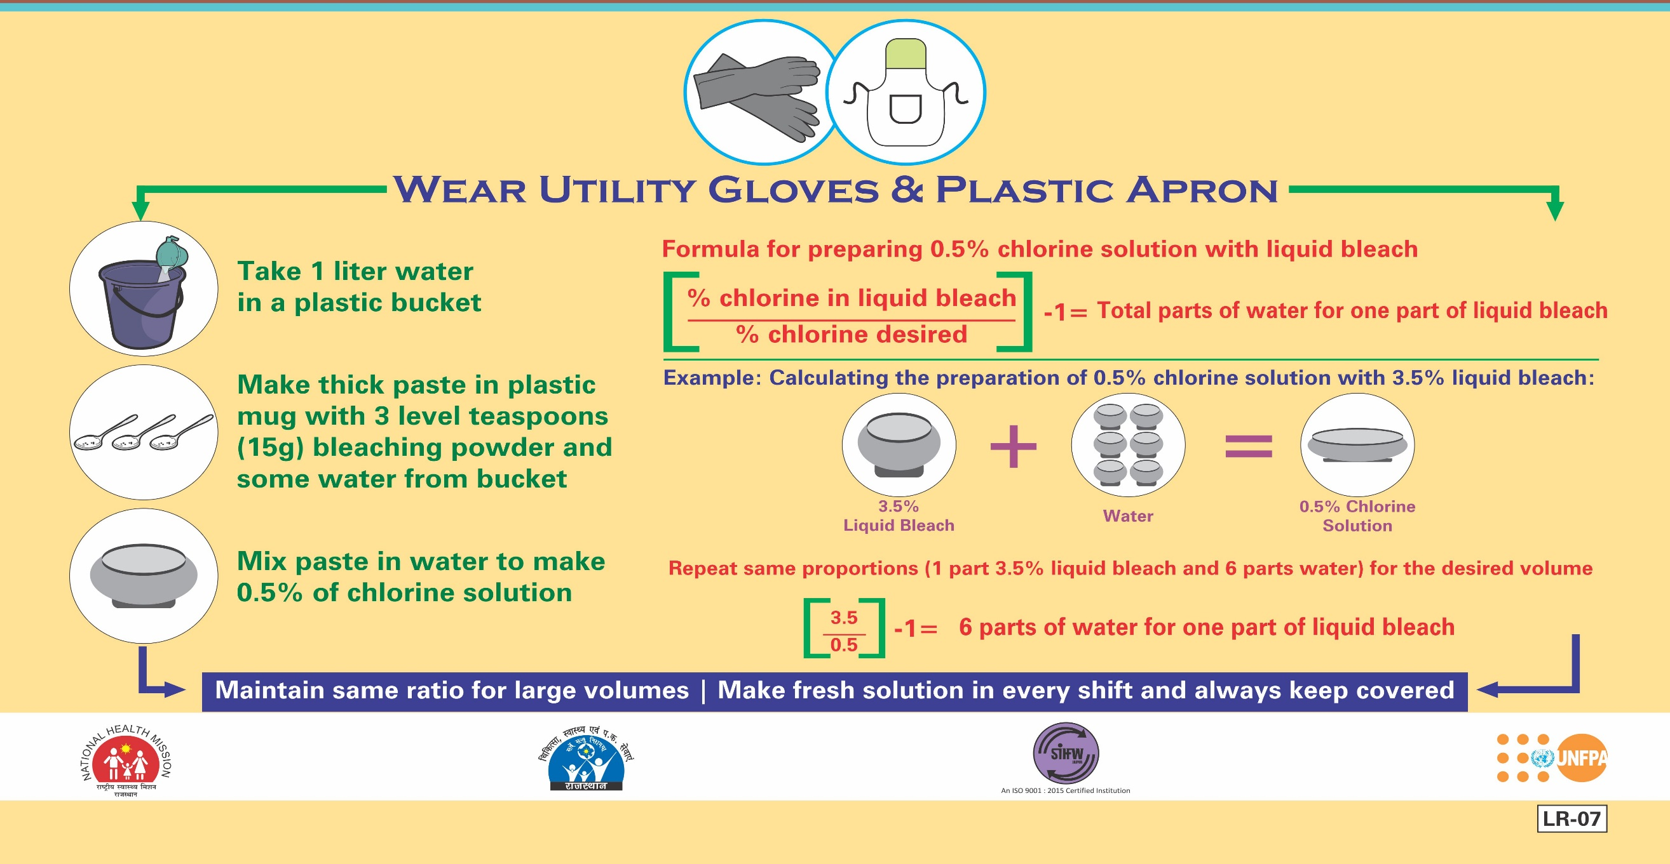
Preparation of Chlorine solution using Hypochlorite Solution

Slide 7
General, Environmental and Frequency of cleaning

Slide 8


Why we required the cleaning
Healthcare environment have a diverse micro-organisms, which can survive for several hours/days
Contaminated surfaces can serve as reservoirs of potential pathogens
Transfer of micro-organisms from contaminated surfaces to patients/staff is mostly via hand contact with the surface
Bacteria grows in dark, moist and unclean places; exposure to sunlight destroys some bacteria

Slide 9
Environmental Cleaning
It is important to ensure that environmental cleaning and disinfection procedures are followed consistently and correctly.
Environmental surfaces or objects contaminated with blood, other body fluids, secretions or excretions should be cleaned and disinfected using standard hospital detergents/disinfectants
The contact period of the chemical with the surface should be min. of 30 Minutes.
Thorough cleaning environmental surfaces with water and detergent and applying commonly used hospital level disinfectants (such as sodium hypochlorite, 0.5%, or ethanol, 70%) are effective and sufficient procedures.
Medical devices and equipment, laundry, food service utensils and medical waste should be managed in accordance with safe routine procedures.

Slide 10
Maintaining Clean Environment
Type of cleaning solution
Uses
Plain detergent and water
To remove dirt & organic material such as grease, oil
Disinfectant
0.5 % chlorine solution
To clean up spills of blood or other body fluids
Disinfectant cleaning solution
For cleaning areas – operation theatres, procedure rooms , latrines
Notes:
Show video on cleaning of labour room

Slide 11
Common cleaning agents and disinfectants for environmental cleaning
Disinfectants | Recommended Use | Precautions
Sodium hypochlorite 1% in-use dilution; 5% solution to be diluted 1:5 in clean water | Disinfection of material contaminated with blood and body fluids | • Should be used in well ventilated areas • Protective clothing required while handling and using undiluted • Do not mix with strong acids to avoid release of chlorine gas • Corrosive to metal
Bleaching powder 7g/L with 70% available chlorine | Toilets/ bathrooms – may be used in place of liquid bleach if this is unavailable | Same as above
Alcohol (70%) isopropyl, ethyl alcohol, methylated spirit | Smooth metal surfaces, table tops and other surfaces on which bleach cannot be used | Flammable, toxic – to be used in well-ventilated area, avoid inhalation • Keep away from heat source, electrical equipment, flames, hot surfaces • Allow it to dry completely, and avoid diathermy burns
Detergent with enzyme | Cleaning endoscopes, surgical instruments before disinfection is essential

Slide 12
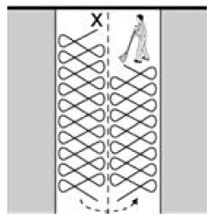
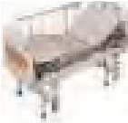


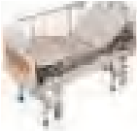

Process of cleaning
Unidirectional flow Eight stroke technique for mopping
START -
Start - First
FIRST
Second
SECOND
THIRD
Third
Fourth
FOURTH
FIFTH -
Fifth - Last
LAST
Nursing station
BMW
Nursing station
BMW
Direction of cleaning : from innermost to outermost

Slide 13

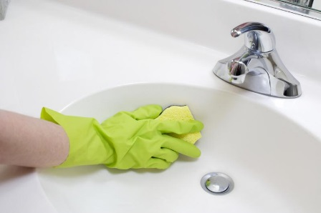
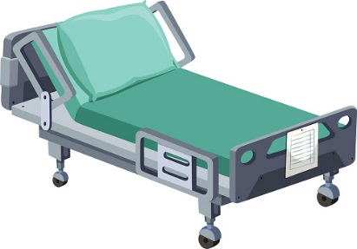
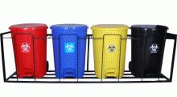
Care of patient’s unit: Daily
Thrice a day
Once a day
Move the furniture
Remove all
unnecessary articles
To be emptied twice a day or more frequently if necessary

Slide 14
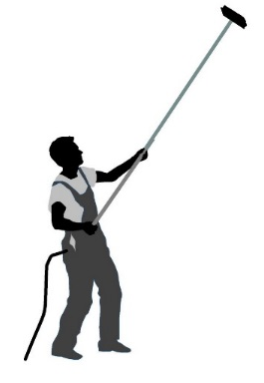
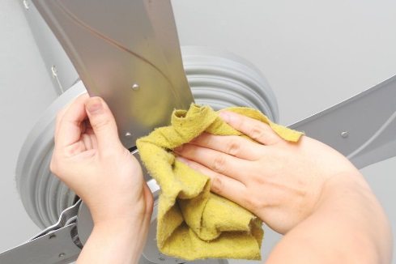
Care of patient’s unit: Weekly
Washing of furniture
and painted surface
Clean roof and walls
Damp dusting of fans
Anything to be repaired should be notified

Slide 15
Frequency of cleaning
S. No. | Activity | Frequency | Agents Used
OPERATION THEATRE / ICU / LABOUR ROOM / NICU / ISOLATION WARDS
1 | Garbage Removal | Thrice a day and more when bags are 3/4th full | As per the BMW guidelines
2 | Cleaning of Instruments | After every procedure | Soap & water followed by sterilization
3 | Cleaning of clean areas and corridors of complex | Twice a day/ as & when required | Damp Mop with detergent and water/ 0.5% chlorine
4 | Mopping. (Care to be taken in case of special epoxy flooring) | Thrice a day and after each procedure | Damp mop with detergent and water / 0.5% chlorine
5 | Cleaning of equipments like anesthesia machines, monitors, ventilators, infant warmers/ baby cribs etc | Twice a day/ as & when required | Damp Mopping , dry, Disinfect with 70% isopropyl alcohol / 2% glutaraldehyde (For endoscopes & reusable items)

Slide 16
Frequency of cleaning
S. No. | Activity | Frequency | Agents Used
OPERATION THEATRE / ICU / LABOUR ROOM / NICU / ISOLATION WARDS
6 | Cleaning of OT table and OT stretcher | Twice a day/ after each surgery | 0.5% chlorine /70% Isopropyl alcohol
7 | Doctor’s / nurses / technician room | Twice a day | Detergent & water
8 | Washroom & wash basins cleaning | Thrice a day and as & when required | Wash with Soap & water, then dry, wipe 0.5% chlorine
9 | Washing of slippers | once a day and when required | Soap & water
10 | Collection of soiled linen and sluicing | As and when required | Soak in clean water with bleaching powder 0.5% for 30 minutes. Wash again with detergent and water to remove the Bleach. OR launder in hot water (70- 80 degree C) if possible.

Slide 17
Disinfecting PPEs used during cleaning (Utility gloves/reusable plastic aprons

Slide 18
Cleaning and Disinfection of Utility/Rubber Gloves:
Utility gloves should be washed with soap and water after every cleaning session
Wash the gloves with soap and water before removing them. Rinse to remove soap. Remove gloves and hang to dry
At the end of the day, wash with soap and water and disinfect by immersion in 0.5% hypochlorite/ chlorine powder solution (dilution as per manufacturer) for one minute. Rinse with plain water and hang to dry overnight.

Slide 19

Thank You !

