Slide 1

Spill Management

Slide 2
Learning objectives for the series

Slide 3
Learning objectives for today
Procedure to handle Mercury spillage
Procedure to handle blood spillage

Slide 4
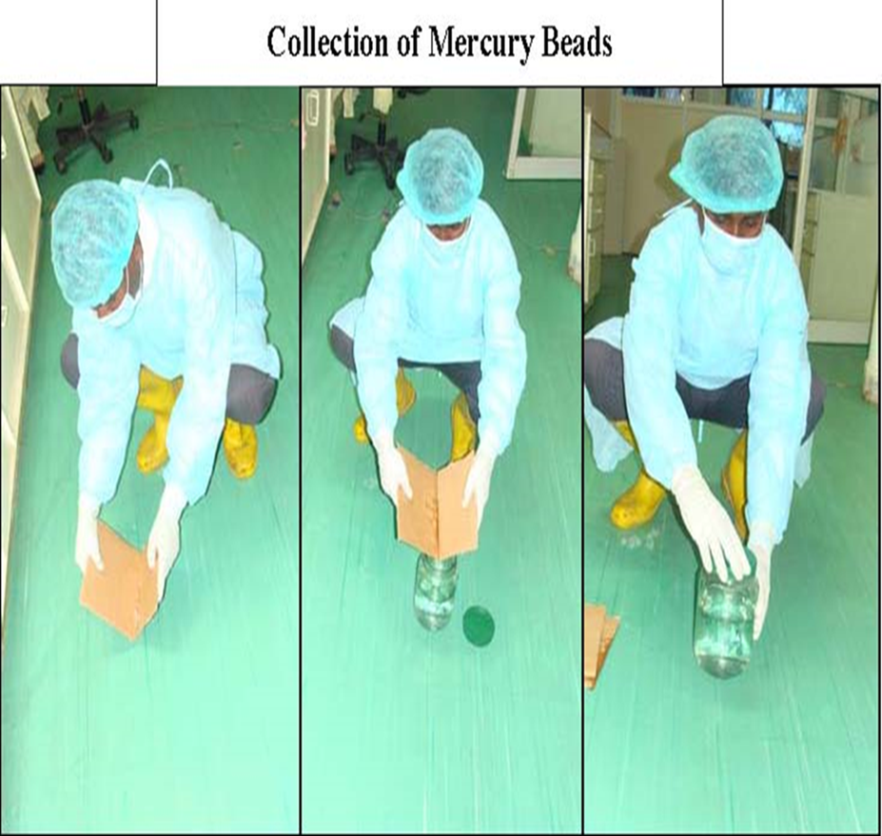
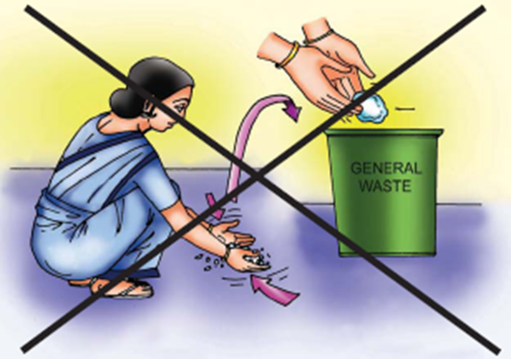
Mercury Spill: Thumb rules
Evacuate the area.
Never touch mercury with bare hands.
Never throw mercury in waste bins or drain.
Never use broom, mop or vacuum cleaner.
Wear all protective gears.
Flashlight (torch) can be used to locate shiny mercury beads.
Gather mercury using 2 cardboard pieces or suck it in a dropper/syringe without needle.
Pour contents of the cardboard/dropper in a bottle containing water.
Tightly close the bottle’s lid & put scotch tape around the bottle.
Place the mercury-contaminated items and instruments (dropper/cardboard) and any broken glass in a plastic zipper bag.
Collected mercury waste should be handed to the CBMWTF or the identified agency of the CPCB.

Slide 5
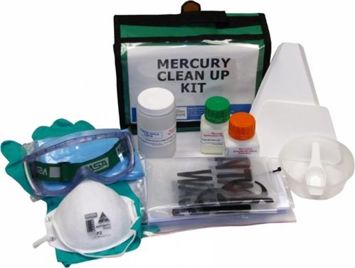

Mercury Spill Kit
A mercury spill kit contains:
PPE
Airtight plastic zipper bag
Dropper
Heavy paper card (or cardboard)
Bottle (plastic or glass)
Airtight puncture proof plastic or steel jar to collect broken glass pieces
Absorbent material (chemical)

Slide 6
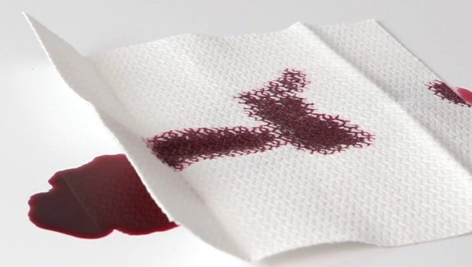
Blood Spill Management
Small Spill
Wear workman’s gloves and other PPE
When sharps are involved use forceps to pick up sharps, and discard these items in a puncture proof container
Wipe the spill with a newspaper moistened with 1% hypochlorite solution. Discard the paper as infected waste
Repeat until all visible soiling is removed
Wipe the area with a cloth mop moistened with 1% hypochlorite solution and allow drying naturally
All contaminated items used in the clean-up should be placed in a bio-hazardous bag for disposal.

Slide 7
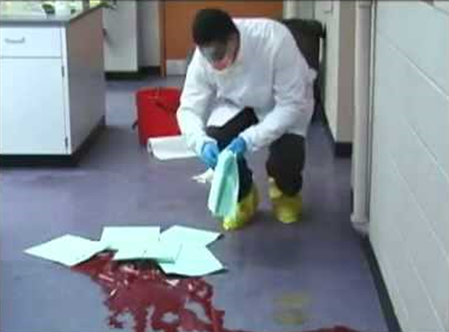
Blood Spill Management
Large Spill (>10ml)
Confine the contaminated area
Wear workman’s gloves and other PPE
Cover the spill with newspaper or appropriate absorbent material to prevent from spreading
Flood the spill with 10% hypochlorite solution. While flooding the spill with 10% hypochlorite solution it is to be ensured that both the spill and absorbent material are thoroughly wet
Alternatively, chlorine granules can be sprinkled on the spill first and then the paper put over it
Wait for five minutes.
Remove and discard the paper as infected waste
Wipe the area with paper moistened with 10% hypochlorite again if required until all visible soiling is cleaned
Wipe the area once with 10% hypochlorite and a cloth mop and allow drying naturally
All contaminated items used in the clean-up should be placed in a bio-hazardous bag for disposal.

Slide 8
Spill Kit
Blood and body fluid spill kit contents:
Workman’s gloves x 2 pairs
Apron
Mask
Shoe cover
Absorbent material like newspaper or blotting paper
Waste collection bag
Cleaning equipment – bucket, mop, cloths, and hypochlorite solution can be obtained from housekeeping and must be washed and disinfected appropriately after use.
All the spill kits must be readily available with all departments especially where risk of spill is more, like laboratory, sample collection room, wards etc.
Spill kit must be immediately replenished after use and stored at the original location after every use.

Slide 9
Display of Spill Management Protocols
Spill management protocols need to be displayed at prominent locations in the hospital.
Displayed protocols serve as a ready reference to the staff for management of spills.
Training of Staff on Spill Management
All the staff in hospitals need to be trained in spill management protocols of the hospital.
Staff must be trained by performing mock drills for spill management.

Slide 10
Review of the session
What are the contents of the Mercury Spill Kit
How will you manage a blood spillage which is more that 20 ml?

Slide 11
Thank you

